Slide 1
Welcome to Leeds!
Paul Flowers – Managing Director, M3

Slide 2
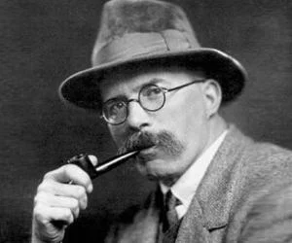
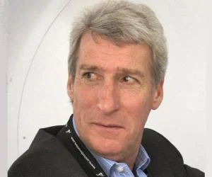
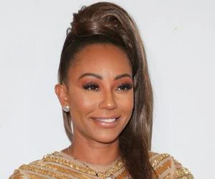
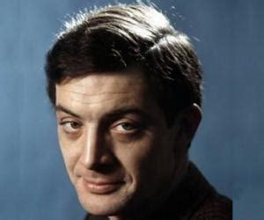
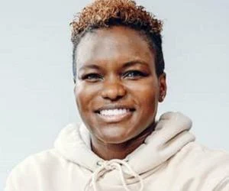
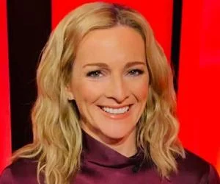
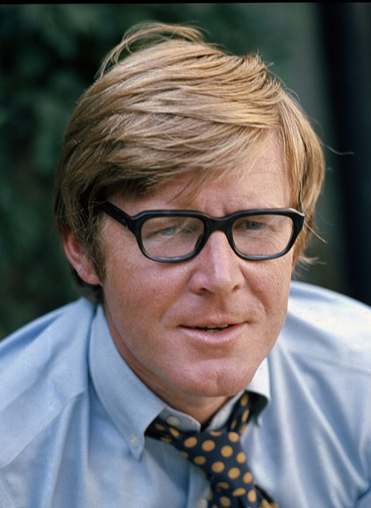
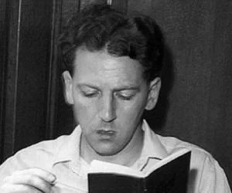
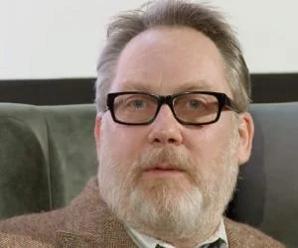
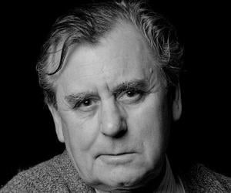
Notes:
Paul

Slide 3
Housekeeping
  Fire alarms, loos
  Breaks, lunches
  Voting slips
Notes:
Paul

Slide 4
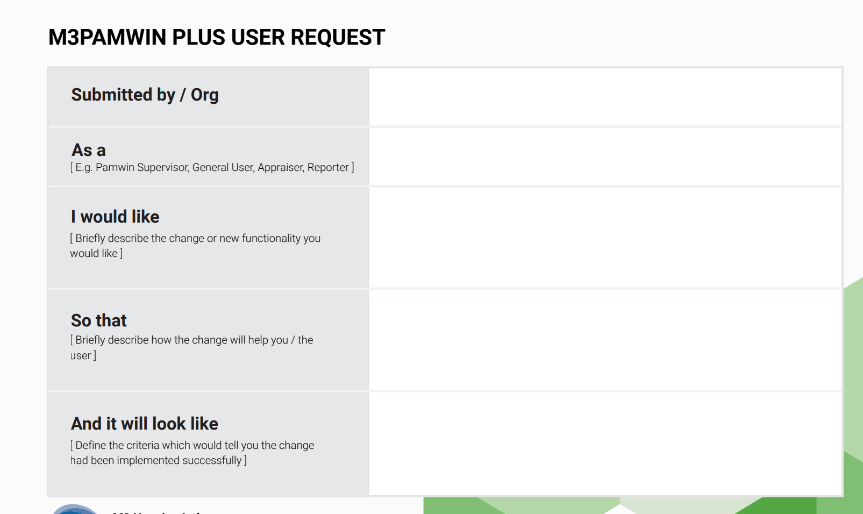

Slide 5
Quick update – things not in timetable
  Benchmarking underway
  Client survey
Notes:
Paul

Slide 6
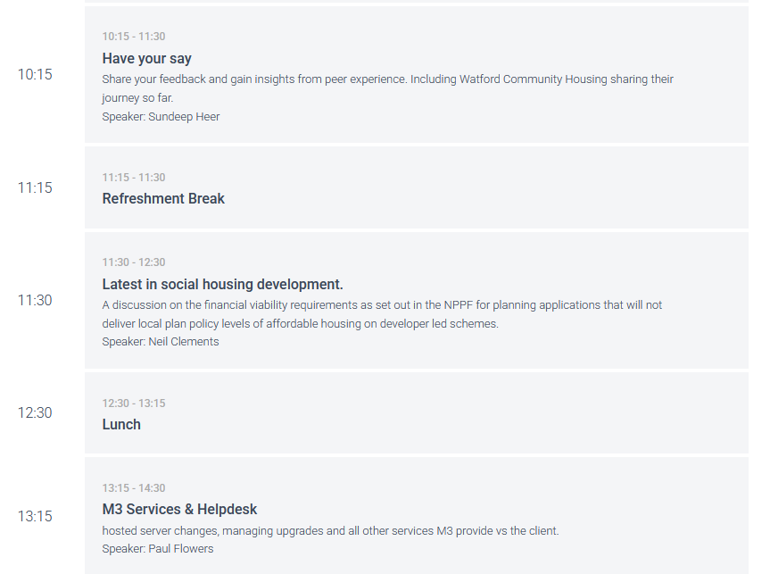
Notes:
Mike Craggs

Slide 7
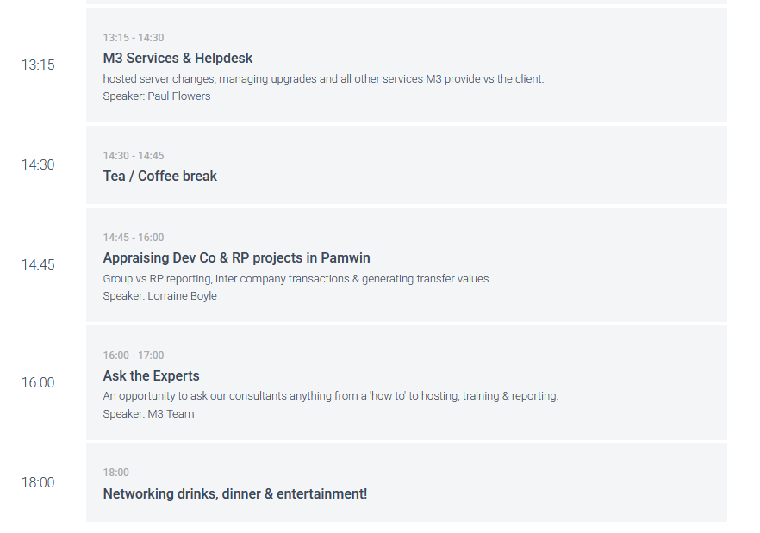
Notes:
Mike Craggs

Slide 8
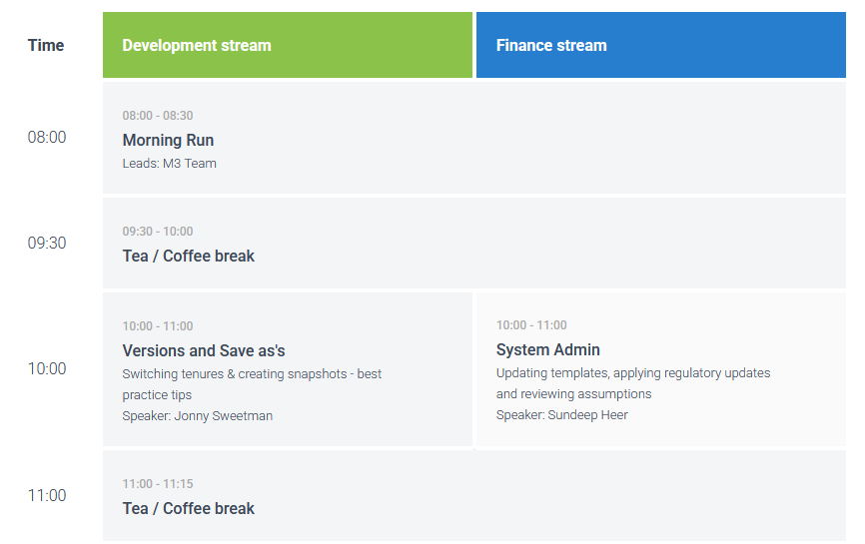
Notes:
Mike Craggs

Slide 9
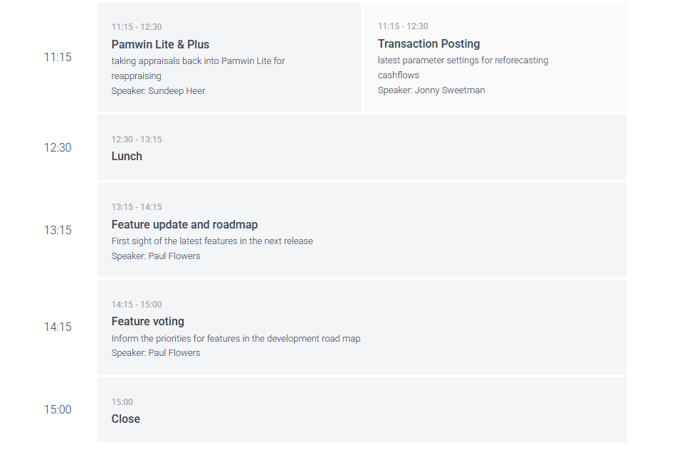
Notes:
Mike Craggs

Slide 10
Welcome to Leeds!
Paul Flowers – Managing Director, M3

