Slide 1
Viability for Planning
(the NPPF way)

Slide 2
Gross Development Value (GDV)
Total sales and/or capitalised net rental income
Market evidence (rather than average figures) from the actual site or from existing developments
Any market evidence used should be adjusted to take into account variations in use, form, scale, location, rents and yields, disregarding outliers
NPPF 2024
Achievable NET incomes must be used

Slide 3
Costs
Build costs based on appropriate data (BCIS for e.g. – BUT not essential)
Abnormal costs, including those associated with treatment for contaminated sites or listed buildings, or costs associated with brownfield, phased or complex sites.
Site-specific infrastructure costs
Total cost of all relevant policy requirements including contributions towards affordable housing and infrastructure, Community Infrastructure Levy charges, biodiversity net gain and any other relevant policies or standards.
General finance costs including those incurred through loans
Professional, project management, sales, marketing and legal costs incorporating organisational overheads associated with the site.

Slide 6
Existing Use Value (EUV)
Be based upon existing use value and should disregard any hope value
Allow for a premium to landowners (including equity resulting from those building their own homes)
Reflect the implications of abnormal costs; site-specific infrastructure costs; and professional site fees
NPPF 2024
This means these should be deducted from the EUV!!

Slide 7
Premium
It is the amount above existing use value (EUV) that goes to the landowner.
Should provide a reasonable incentive for a landowner to bring forward land for development while allowing a sufficient contribution to fully comply with policy requirements
Market evidence can include benchmark land values from other viability assessments
Any data used should reasonably identify any adjustments necessary to reflect the cost of policy compliance (including for affordable housing), or differences in the quality of land, site scale, market performance of different building use types

Slide 8
Benchmark Land Value (BLV)
EUV plus premium (EUV+)
The premium should provide a reasonable incentive for a land-owner to bring forward land for development while allowing a sufficient contribution to fully comply with policy requirements
Alternative Use Value (AUV) – can be considered but:
  ‘should be limited to those uses which would fully comply with up-to-date development plan policies’
NPPF 2024

Slide 9
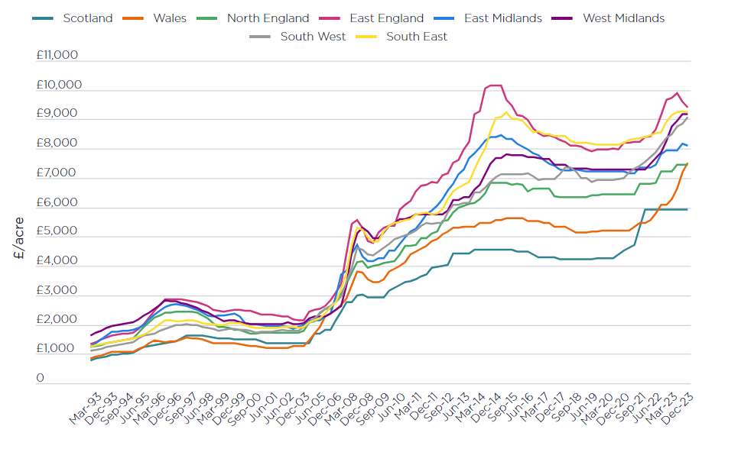
Existing Use Value (EUV) – Agricultural Land Values
Agricultural land values (England) Savills 2024

Slide 10
Premium
It is the amount above existing use value (EUV) that goes to the landowner.
Should provide a reasonable incentive for a landowner to bring forward land for development while allowing a sufficient contribution to fully comply with policy requirements
Market evidence can include benchmark land values from other viability assessments
Any data used should reasonably identify any adjustments necessary to reflect the cost of policy compliance (including for affordable housing), or differences in the quality of land, site scale, market performance of different building use types

Slide 11
Developer Return
15-20% of gross development value (GDV) may be considered a suitable return to developers
A lower figure may be more appropriate in consideration of delivery of affordable housing in circumstances where this guarantees an end sale at a known value and reduces risk
Alternative figures may also be appropriate for different development types
NPPF 2024

Slide 12
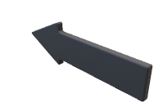

The Local Plan Nirvana
Community
Cheap Housing
Quality Housing
Affordable Housing (?)
Play areas
Community stuff
Landowner
‘Decent’ land value
Government (N&L)
Building regs (net zero one day)
All Housing (OM and AH)
Good design
Economic activity
CIL £
Developer
‘Reasonable profit’
Turnover

Slide 13
Incentivising sale of land
Worked example near Truro 20 plots – 4.1 acres
EUV – £9700 per acre
Premium, say, 20% - £1940/acre
BLV £11,640
£3181 per plot
£30 billion agricultural income (England)
42 million acres of land in use
£701.38/acre income
30 year income from 3.5 acres - £73,644
  ‘Hope’ Value?
  Selling the family silver
  Emotion
  Reduced efficiency
But Ultimately EUV represents replacement cost of the asset with a similar one and is therefore, to all intents and purposes, ‘Market Value’ at its current use.

Slide 14
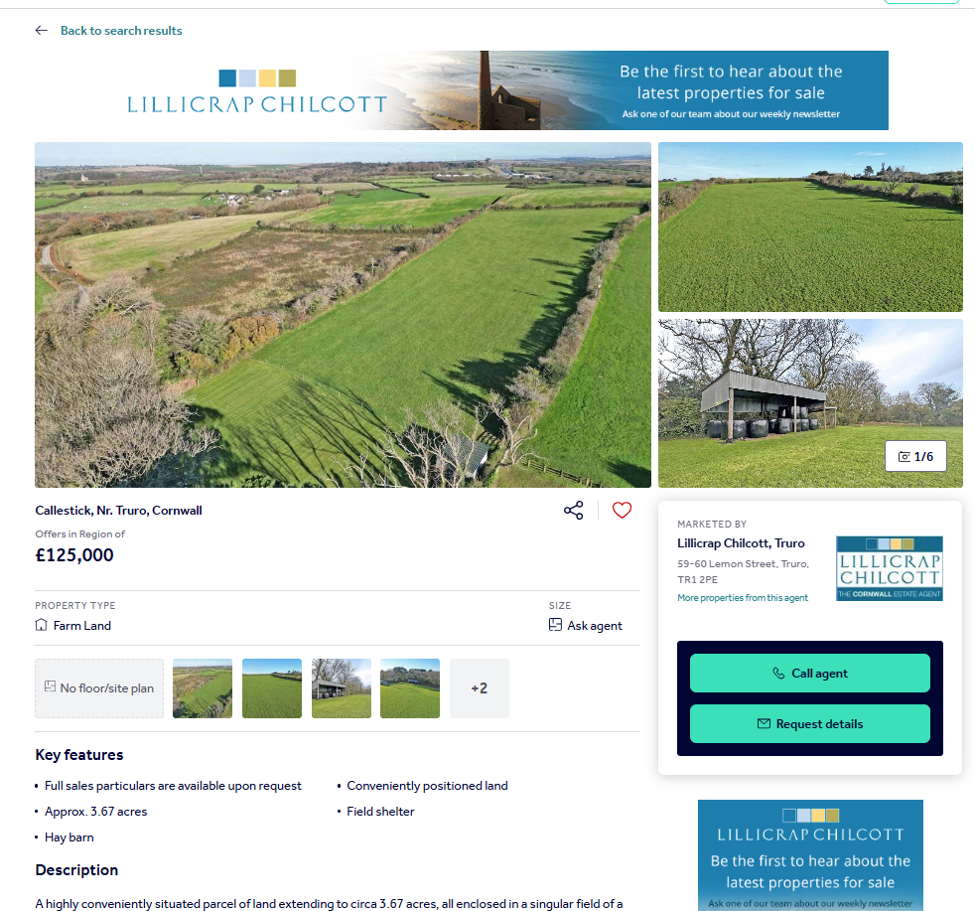
Worked example near Truro 15 plots – 4.1 acres
  Replacement site (less buildings) £27,247/acre
  Premium, say, 20% £5449/acre
  BLV £32,696/acre
  Giving £134,055 as BLV

Slide 15
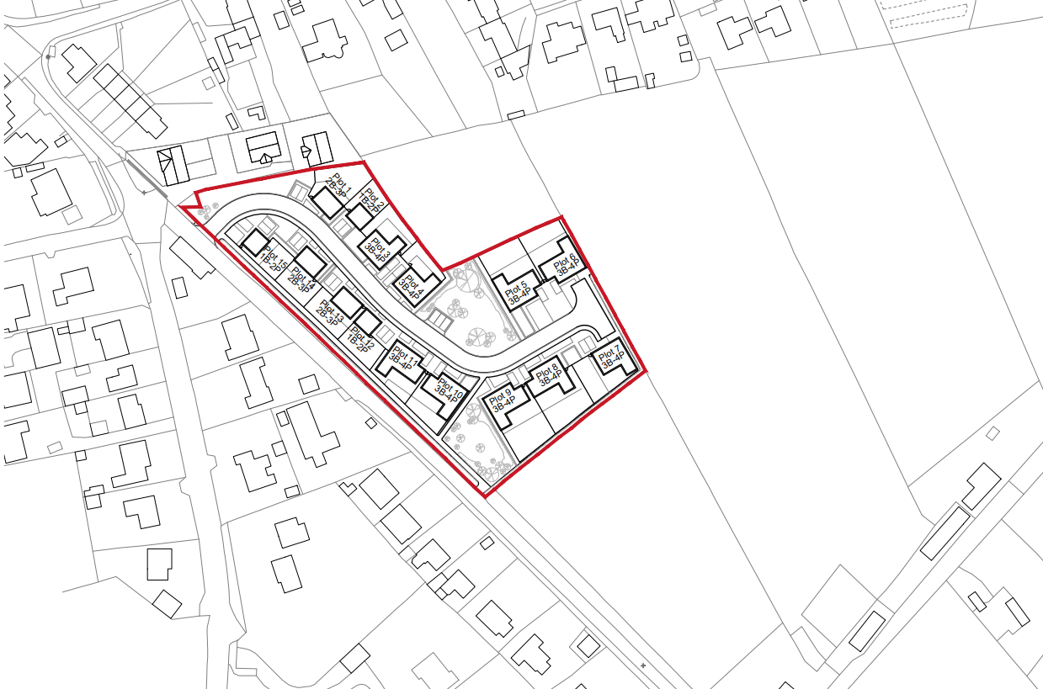

Slide 16
Achievable incomes – not marketing prices
Gross Development Value (GDV)
Type | No. | M2 | Value | Total
4 bed detached OM | 6 | 135 | £500,000 | £5,000,000
2 bed house SO | 1 | 79 | £253,750 | £253,750
3 bed house SO | 1 | 93 | £300,500 | £300,500
1 bed House AR | 3 | 58 | £111,596 | £334,788
2 bed house AR | 1 | 79 | £143,531 | £143,531
3 bed house AR | 3 | 93 | £173,200 | £519,600
 | 15 |  |  | £4,552,169
Present values

Slide 17
Costs
NET build cost – i.e. not a D&B price –The profit for the scheme is in the development margin NOT the construction
BCIS will provide a base price but does not include external works, professional fees or any abnormal costs so use it cautiously

Slide 20
