Slide 1
M3Pamwin Plus User Group
10 September 2020 | Virtual

Slide 2
Session 1 Right to Shared Ownership Model
M3 PamwinPlus User Group | 2nd December 2020
Sundeep Heer
Head of Implementation| M3
m3h.co.uk
020 8274 4000

Slide 3
Key Features;
Purchase a social or affordable rent property
Buy shares between 10% and 75%
Repairs & maintenance met by landlord for 10 years
Staircase to full ownership
Notes:
On the 8th September 2020 the government announced a new product ‘Right to Shared Ownership’ under the Affordable Homes Programme 2021-26.
Main features of the scheme are;
1.1. The Right to Shared Ownership will allow eligible tenants who occupy eligible properties to purchase their social or affordable rented on Shared Ownership terms.
1.2. Tenants will be able to buy between 10% and 75% of their home (as per the current Shared Ownership rules). The price of the share will be based on a percentage of the full market value as determined by a Royal Institution of Chartered Surveyors (RICS) qualified independent valuer. The scheme does not involve a discount for the tenant.
1.3. The requirements regarding the rent, service charges, maintenance and repairs for the Right to Shared Ownership is the same as for the new Shared Ownership model. (lower increments for staircasing, and repairs costs to be met by the landlord for the first 10 years)
1.4. Tenants will then be able to buy further shares and staircase to full ownership, in line with the rules of the new standard Shared Ownership scheme.
The majority of rented homes built through the programme will have the Right to Shared Ownership attached, although there will be certain criteria that tenants need to meet to be eligible:
You will need to be a social tenant for at least three years, and have lived in the current property for at least 12 months.
You will need to have a maximum household income of £80,000 or less – or £90,000 in London.
You will need to demonstrate that you can afford and sustain homeownership; all prospective purchasers will be required to undertake an affordability assessment.
You must not be subject to bankruptcy proceedings.

Slide 4
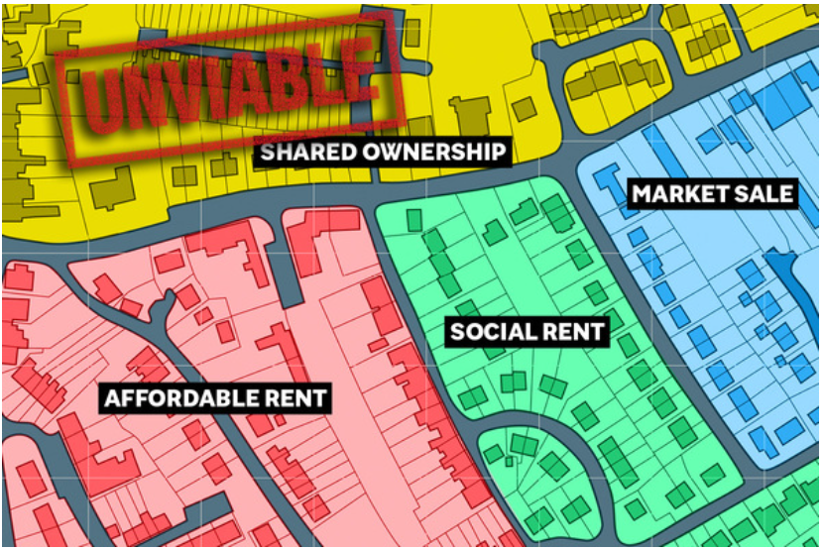
Initial Responses.
Brendan Sarsfield, chief executive at Peabody, said the new policy “feels as if it’s been plucked out of thin air”
Catherine Ryder, director of policy and research at the National Housing Federation "Housing associations will need to think carefully about how they factor the additional potential risks. We will be looking to influence the detail, for example on grant rates, to make sure shared ownership remains a viable product to build and an attractive product for people looking to buy."
Nick Lieb, Head of Operations at Share to Buy, comments:
“We are sure this will prove to be a major step forward for hopeful buyers up and down the country from 2021, and we expect to see rising numbers of registrations in the New Year as a result.”
Matthew Bailes, chief executive at Paradigm: “Given the existing risks around the housing market, our reliance on sales margins to cross-subsidise rented homes, and the potential implications of Right to Shared Ownership, we are going to have to reflect on our development strategy going forward.
We want to develop at scale, but additional uncertainty makes it harder. Uncertainty on these issues will also reduce our risk appetite.”
Markus Kendall-Young, Group Head of Marketing and Sales at Catalyst, comments:
“The changes to Shared Ownership, including a lower initial minimum share purchased of 10% for some properties, is likely an exciting prospect for many first time buyers, which could make home ownership more attainable”

Slide 5
Viability of; Rent V RTSO SO V New SO

Slide 6
New Shared Ownership Assumptions
%‘gradual’ & regular staircasing?
10 year free repair period (10 yrs from build completion, max £500)
Service Charges – unchanged?

Slide 8
Rent v RTSO? Old SO v New SO? Cross Subs? What happens to the cross subs? Do you take a hit?
Notes:
Half of the homes funded through the upcoming £12bn programme, which will run from 2021 to 2026, will be for affordable homeownership, with the remaining for discounted rent, including 10% for supported housing.
The announcement marks a rebalancing of government grant funding in favour of affordable homeownership tenures. Homes England data shows that between 2016 and 2019, 44% of grant-funded homes were for affordable homeownership, compared to 56% for rented tenures.
It comes as the government also announces a new model for shared ownership, which reduces the minimum initial share you can buy in a property from 25% to 10%.
Under the new model, residents will be able to buy additional shares in their homes in 1% instalments, rather than the current 10%, and landlords will be required to cover the cost of repairs and maintenance for an initial 10-year period.

Slide 9
This is the title for this slide. Max 3-4 lines only.
This is a bullet list title.
This is the inner paragraph.
This is another bullet list title. Max 2 lines please.
This is the inner paragraph. Ideally, description text is kept at a max 2-3 lines.
Last bullet list item.
If you need more items on your list, just duplicate the slide, keep the title, and add your items to the list on the next slide.

Slide 10
You may use this for paragraph items.
This is a sub title.
This is the inner paragraph. You may take out the sub title above if not required.
Proin non velit ac odio porttitor mollis sit amet nec nunc. Maecenas euismod sodales tincidunt. Sed malesuada justo ut interdum vulputa
Aenean ultrices mattis aliquam. Phasellus nisl lacus, ultricies eget sem eu, blandit semper lacus. Maecenas euismod sodales tincidunt. Sed malesuada justo ut interdum vulputate. Integer vestibulum sagittis purus et viverra. Suspendisse vel dictum nisi.

Slide 11
You may use this for paragraph items.
This is a sub title.
This is the inner paragraph. You may take out the sub title above if not required.
Proin non velit ac odio porttitor mollis sit amet nec nunc. Maecenas euismod sodales tincidunt. Sed malesuada justo ut interdum vulputa
Aenean ultrices mattis aliquam. Phasellus nisl lacus, ultricies eget sem eu, blandit semper lacus. Maecenas euismod sodales tincidunt. Sed malesuada justo ut interdum vulputate. Integer vestibulum sagittis purus et viverra. Suspendisse vel dictum nisi.

Slide 12
You may use this for paragraph items.
This is a sub title.
This is the inner paragraph. You may take out the sub title above if not required.
Proin non velit ac odio porttitor mollis sit amet nec nunc. Maecenas euismod sodales tincidunt. Sed malesuada justo ut interdum vulputa
Aenean ultrices mattis aliquam. Phasellus nisl lacus, ultricies eget sem eu, blandit semper lacus. Maecenas euismod sodales tincidunt. Sed malesuada justo ut interdum vulputate. Integer vestibulum sagittis purus et viverra. Suspendisse vel dictum nisi.

Slide 13
This is a more traditional bullet list.
This is a sub title. You may remove this if not required.
This is the inner paragraph. You may take out the highlighted sub title if not required.
Proin non velit ac odio porttitor mollis sit amet nec nunc. Maecenas euismod sodales tincidunt. Sed malesuada justo ut interdum vulputa
Aenean ultrices mattis aliquam. Phasellus nisl lacus, ultricies eget sem eu, blandit semper lacus. Maecenas euismod sodales tincidunt.

Slide 14
This is a more traditional bullet list.
This is a sub title. You may remove this if not required.
This is the inner paragraph. You may take out the highlighted sub title if not required.
Proin non velit ac odio porttitor mollis sit amet nec nunc. Maecenas euismod sodales tincidunt. Sed malesuada justo ut interdum vulputa
Aenean ultrices mattis aliquam. Phasellus nisl lacus, ultricies eget sem eu, blandit semper lacus. Maecenas euismod sodales tincidunt.

Slide 15
This is a more traditional bullet list.
This is a sub title. You may remove this if not required.
This is the inner paragraph. You may take out the highlighted sub title if not required.
Proin non velit ac odio porttitor mollis sit amet nec nunc. Maecenas euismod sodales tincidunt. Sed malesuada justo ut interdum vulputa
Aenean ultrices mattis aliquam. Phasellus nisl lacus, ultricies eget sem eu, blandit semper lacus. Maecenas euismod sodales tincidunt.

Slide 16
This is a feature title with an image
You may also add a short description if required. Note that in most instances, a title should be enough.

Slide 17
This is a feature title with an image
You may also add a short description if required. Note that in most instances, a title should be enough.

Slide 18
This is a feature title with an image
You may also add a short description if required. Note that in most instances, a title should be enough.

Slide 19
Product roadmap
1995
Entrepreneurial activities differ substantially depending on the type.
2000
Entrepreneurial activities differ substantially depending on the type.
2010
Entrepreneurial activities differ substantially depending on the type.
2015
Entrepreneurial activities differ substantially depending on the type.

Slide 20
1995
Entrepreneurial activities differ substantially depending on the type.
2000
Entrepreneurial activities differ substantially depending on the type.
2005
Product roadmap.
Entrepreneurial activities differ substantially depending on the type.
2015
Entrepreneurial activities differ substantially depending on the type.

Slide 21
Showing a key item with an image.
KEY ITEM
You may also add a short description if required. Note that in most instances, a title should be enough.
Entrepreneurial activities differ substantially

Slide 22
Showing a six month graph
75M
65M
54M
33M
50M
45M
A company is an association or collection of individuals, whether natural persons, legal persons, or a mixture of both. Company members share a common purpose

Slide 23
Monthly chart comparison
Item 1
Item 2
Item 3
Item 4
A company is an association or collection of individuals, whether natural persons, legal persons, or a mixture of both. Company members share a common purpose and unite in order to focus their various talents and organize their collectively available .

Slide 24
If you need a pie graph.
You may also add a short description if required. Note that in most instances, a title should be enough.
Item name 1
Item name 2
Item name 3
Item name 1
Item name 2
Item name 3

Slide 25
Showing a graph with 3 categories
You may also add a short description if required. Note that in most instances, a title should be enough.
A company is an association or collection of individuals, whether natural persons, legal persons, or a mixture of both. Company members share a common purpose and unite in order to focus their various talents and organize their collectively available .

Slide 26
A demographic chart
=
71%
=
53%
A company is an association or collection of individuals, whether natural persons, legal persons, or a mixture of both. Company members share a common purpose.

Slide 27
This is a feature title with an image to the right.
You may also add a short description if required. Note that in most instances, a title should be enough.

Slide 28
Thank you all for attending!
Update event name | 03 December 2019

Slide 29
Questions?
Update event name | 03 December 2019

Slide 30
Questions?
Update event name | 03 December 2019

Slide 31
Presentation Title here
Presentation venue | 03 February 2020
Presented by:
Paul Flowers
Managing Director | M3
m3h.co.uk
020 8274 4000

