Slide 1



Save As
Malmaison | 09 July 2025
Presented by:
Jonny Sweetman
Technical Director | M3
m3h.co.uk
020 8274 4000

Slide 2
Save As
Approving
Save As
Save As Version
Remodelling
What happens to transactions?
Copying properties
Snapshots

Slide 3
Approving
The original figures are saved
  This includes:-
  Appraisal figures
  KPIs
  Cashflow
  Timetable
  Unit data
  Custom fields
  Accounts are locked

Slide 4
Quick note on baselining
Notes:
Why would you want to do this? Entering into contract or start of the financial year. Has anyone used baselining? You would probably have a company policy on when to baseline so it’s consistent across tenures. Check if selection button works

Slide 5
Budget monitoring graph
Notes:
PRM can pick up the original and baseline

Slide 6
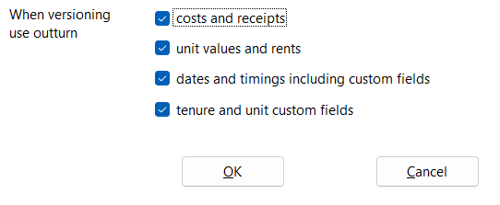
Save as version…

Slide 7
What happens to the cashflow? And interest!
Notes:
Mention the fixed cashflow – if you start posting you will want to check for discrepancies and unfix the payments. If you are remodelling you will want to unfix some or not use outturn cashflow

Slide 8
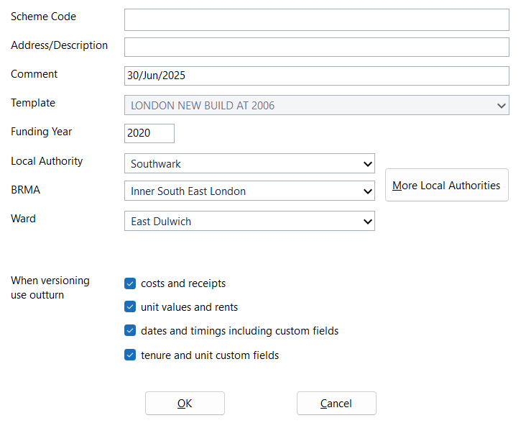
Save as…

Slide 9
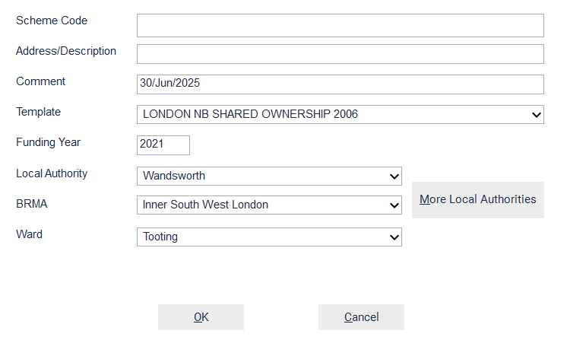
Switch tenure…
Only at tenure level
Only if unapproved

Slide 10
What is copied where?
From original tenure | From template
Scheme general data (location, inflation, etc.) Timetable Staircasing Custom fields Properties and units (and rent amounts) Everything else | Assumptions (Patterns, Interest Calcs, etc.) Add or remove sales stages Including date dependencies to completion Dependencies Rent calcs Missing accounts and notes Missing custom fields
Notes:
Rent % and rental method need checking

Slide 11
Splitting costs
How do you remodel costs if you are converting some units to a different tenure?
  Future roadmap item – project level costs
  Project accounts spreadsheet

Slide 12
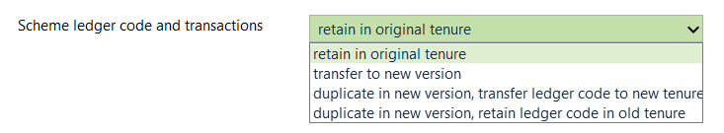
Transactions
Notes:
When would you use each version? Give a clear example.
Supervisor only for moving codes
If I change my mind how do I change the ledger code later? Unattaching transactions and changing ledger

Slide 13
Why would you want to duplicate transactions?
  Remodelling
  Fixing cashflow and reforecasting spend
Notes:
Remember to

Slide 14
Copying properties
Easy way to move properties from one tenure to another in a project
Copy Cut Paste

Slide 15
What gets copied?
Property | Property Type
Everything else Units (Address, Custom fields, Handover data, dates) | Plot number Revenues Rents, sold percents Units (Rents, Final Services, Date dependencies)
Notes:
Revenues and rent % amount

Slide 16
Snapshots
Set up in data maintenance
Creates a copy of a scheme at a point in time
Can be viewed in Pamwin
Stores the Revenue Forecast
Notes:
Just turn it on

Slide 17
Reporting on snapshots
Note:

Slide 18
Information available on our website

Slide 19
Questions?
Save as… | 09 July 2025

Slide 20
Thank you all for attending!
Save as… | 09 July 2025

