Slide 1


Private Developer Appraisals and Intercompany options
Presenter
Lorraine Boyle F.C.C.A
Senior Consultant
m3h.co.uk
020 8274 4000

Slide 2
What is the Private Developer Model?
When should we use it?
How do we use it?

Slide 3
What is the Private Developer Model Approach?
A method of appraising a project in Pamwin Plus from the Developer perspective

Slide 4
How does it work?
Dev Co would enter into a contract with Contractor to develop all units for sale
RP enter into a contract with Dev Co to purchase Affordable units
Agreement between Dev Co and RP may include stage payments or payment on completion

Slide 6
How do we use it?
All units both private and affordable are for Sale
Private sale valued at OMV
Affordable – Various options for calculating Value
Appraisal to show private and affordable income streams and all relevant costs

Slide 7
When to use it?
Does the affordable viability change as outturn costs change, or is the price (and hence viability) fixed at the outset?
  If it changes, use the traditional Project model
  If it is fixed, use the Private Developer

Slide 8
 | Land Trust | Micro Housing Association | Multi-function Development Department | Development split new business/ delivery | Development with VAT vehicle DevCO | Development with DevCO as private developer
Lite | CLT model | Yes | Optional | Could use for new business | Could | Could
Plus – Multi Tenure Projects | No | Optional | Yes | Yes | Could | Depends
Plus – Private Developer | No | No | Unlikely | Could | Should | Must
Sync | No | Overkill | Optional | Optional | Optional | Optional

Slide 9
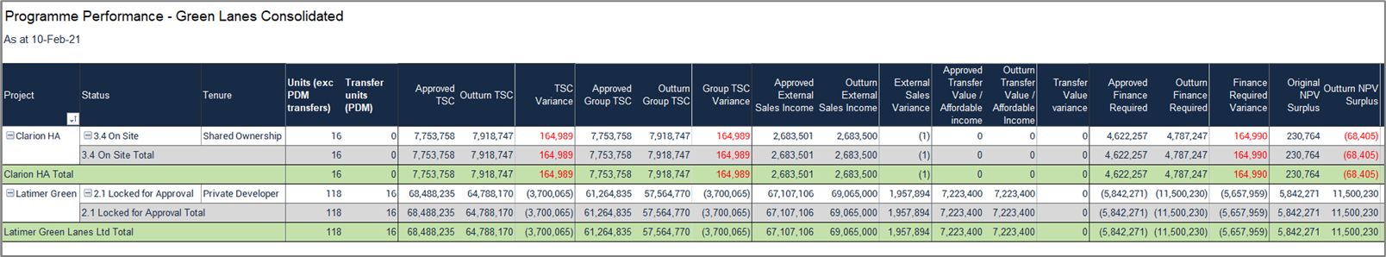

Slide 10
Appraising with Dev Co – Non PDM
Use traditional Project method
Single tenures making up a project
Set up internal transfers to track payments between RP and Dev Co

Slide 11
Intercompany
What is it/ how does it work?
What are the different ways to use it ?
Abri/Home Group
What Reports can we use?

Slide 12
What is it/ how does it work?
Method of reporting the cashflow and internal transfers between RP and Dev Co.
Pamwin can be set up with Internal transfers for Land/ Build & on-costs.
Costs from all ledgers can be uploaded into Pamwin

Slide 13
How can we set it up?
Intercompany accounts are set up in pamwin
Developed for and initial payers are established
Mark up/profit margin agreed and set in pamwin

Slide 14
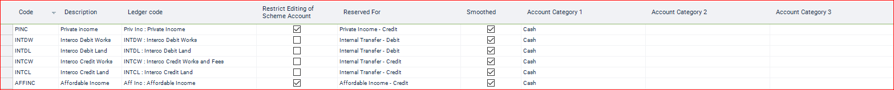

Slide 15
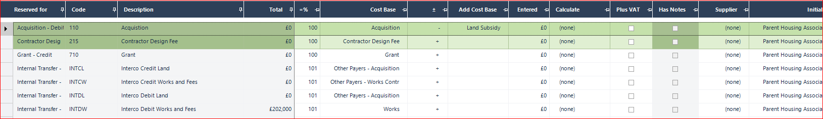

Slide 16
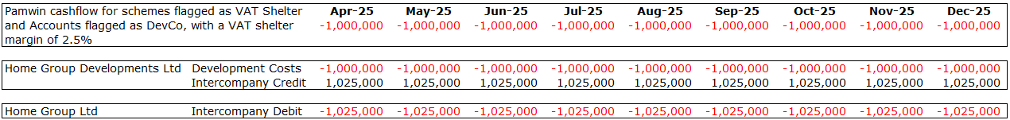
Intercompany Transactions: VAT Shelter Schemes
We’ve tried a couple of approaches to this over the years, but have settled on using reporting outputs to give us intercompany cashflows, using the following Pamwin inputs:
Financial setup: This field dictates the financial structure of the scheme and in input at a tenure (scheme) level. We use ‘Agency Type’ (Scheme details > Codes) as a proxy field as this is usable in Selection filters, whereas custom fields are not. On of the options in this dropdown is ‘VAT Shelter’, allowing us to apply logic only to these schemes.
Initial payer: an account level field used to flag which accounts are being paid by DevCo entity
VAT Shelter margin: A custom field which details what margin the DevCo entity is applying to costs
Developed for: scheme level field used to flag which entity is paying the DevCo entity to act as developer
Using these fields we can use the data from Pamwin to create cashflows for both entities in a VAT Shelter Scheme:

Slide 17
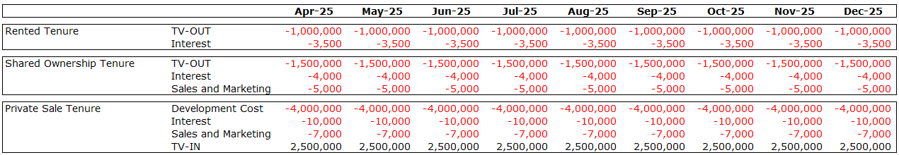
Intercompany Transactions: Fixed Price Deal
We have Private Sale and Affordable tenures in the same project, with the Private Sale tenure acting as the DevCo and use two accounts to manage the Intercompany cashflow; Transfer Value In (TV-IN) and Transfer Value Out (TV-OUT).
Costs sit on appropriate tenures
  Affordable Tenures: TV-OUT account (debit) is amount paid to DevCo for homes, and any other costs such as interest and sales & marketing for affordable homes also sit on these tenures
  Private Sale Tenure: TV-IN account (credit) equalling the sum of all TV-OUT accounts on affordable tenures, plus all development costs and any sales and marketing costs for private units

Slide 18
What reports can we use
PRM has a report for Intercompany cashflow
This shows when money is spent by Dev Co and when RP reimburses the Dev Co
Any mark up by the Dev Co can also be reported.
Bespoke reports

Slide 19
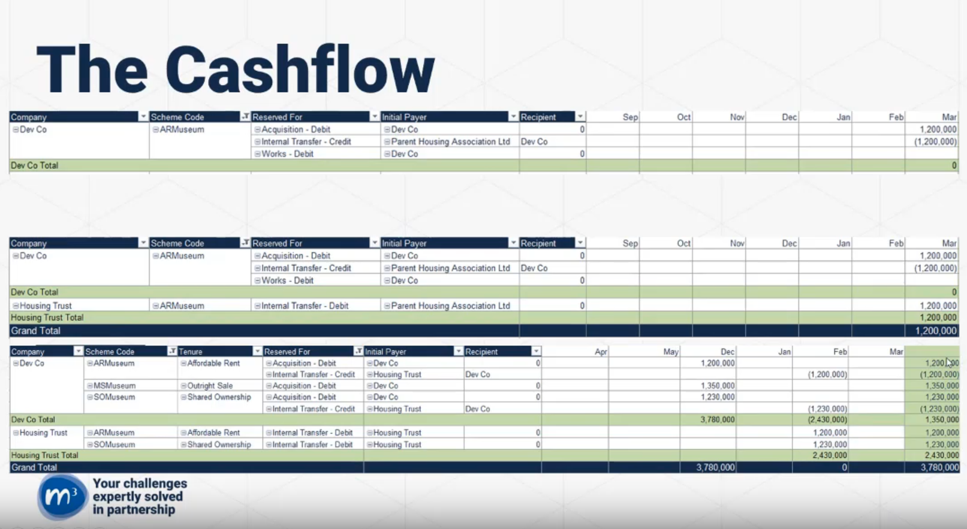

Slide 20
Updated Guidance on the M3 Website
Private Developer Appraisal
How to set up intercompany (video & guidance note)

