Slide 1
M3Pamwin Plus User Group
10 September 2020 | Virtual

Slide 2
Session 1 Adjusting and reporting on your new programme
M3 PamwinPlus User Group | 10 September 2020
Sundeep Heer
Head of Implementation| M3
Matt Snuggs
Associate Director (Product) | M3
m3h.co.uk
020 8274 4000

Slide 3
… A (very) quick history of Social Housing Development.

Slide 4
The Early Years.
Small Sites
Mostly S106 procurement
Limited to rent points(?)/ target rent. Very little mixed tenure
PamKit is born out of necessity to appraise and value long term rented stock

Slide 5
1990s onwards...
Exploring land led options
New Tenures – Shared Ownership, Keyworker Intermediate Rent etc…
Changing Grant regimes – Capital vs. Revenue funding
The concept of a Development Programme become reality
Pamkit becomes Pamwin – desktop application and centralised database

Slide 6
Into the new millenium
HAs finding their feet in funding markets, bonds, etc
Outright Sale to cross-subsidise Social Purpose
Direct purchase and assembly of larger sites, JVs, SPVs, etc…
Pamwin becomes Pamwin Plus – multi-tenure and flexible to the changing regulatory and funding markets.

Slide 7
The R word
Costs at Risk
Exposure to Market
Socio-political uncertainty (The C word)

Slide 8
“What’s Pamwin Plus ever done for us?”

Slide 9
Cost at Risk - Posting to unapproved schemes

Slide 10
Multi Tenure, multi-phased sites
Market Sale, Commercial, Retail and Leisure all in one place.
Phased Handovers and Rents
Flexible stages

Slide 11
Unit Mix changes – Unadoption / Readoption?

Slide 12
Approvals process
From this….

Slide 13
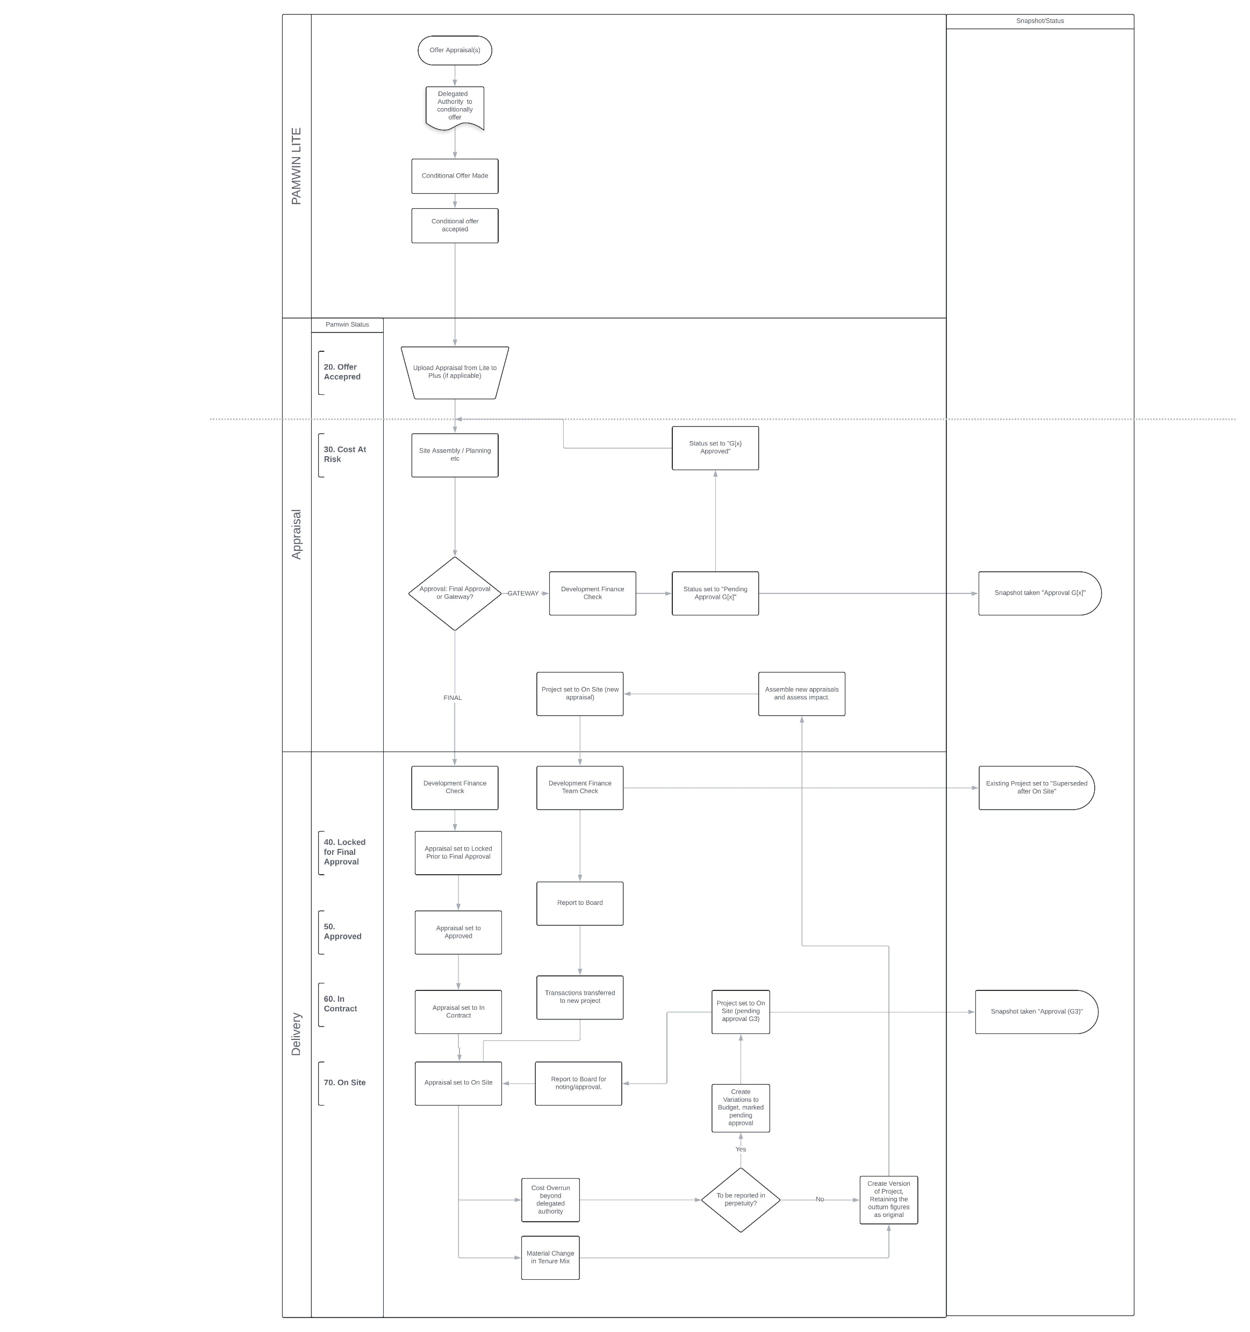
Approvals process
To this….

Slide 14
Project & Programme Changes
Switching tenures
Versioning
Adjusting main assumptions
Creating snap shots
Reporting

Slide 15
Scenarios, options & what if
Single tenure changes – unit mix or tenure
Global assumption changes – inflation & borrowing rates
Calculation changes - revenue forecast parameters & sensitivities

Slide 16
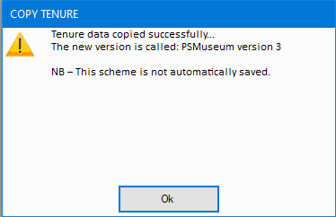
Appraisal changes
Save as version
Carbon copy of the unlocked appraisal(s) automatically named version 2
Useful for doing options for the same site (user templates)

Slide 17
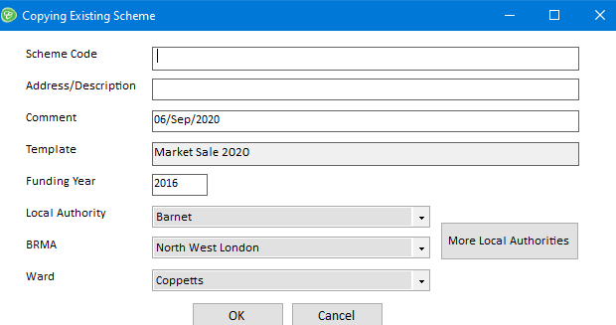
Appraisal changes
Save as
Carbon copy of the unlocked appraisal with the ability to change tenure details but not the tenure (template)
Still able to change units, costs, timetable
Useful for doing multiple appraisals for similar sites/offers

Slide 18
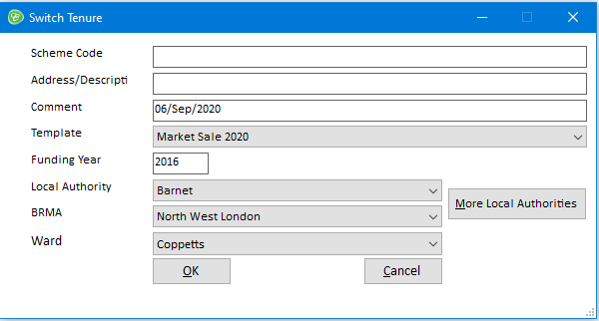
Appraisal changes
Switch Tenure
Carbon copy of the unlocked appraisal with the ability to change tenure details AND the tenure (template)
Still able to change units, costs, timetable
Useful for doing multiple appraisals for similar sites/offers

Slide 19
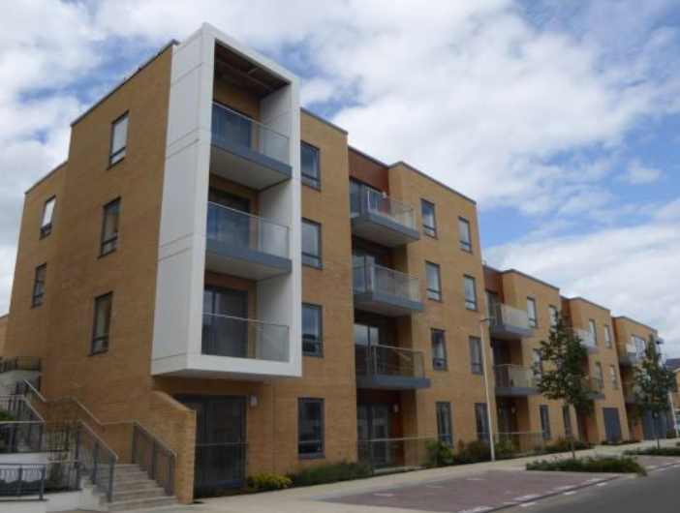
Post Approval changes
Outturns
Costs
Timetable
Rents
Values

Slide 20
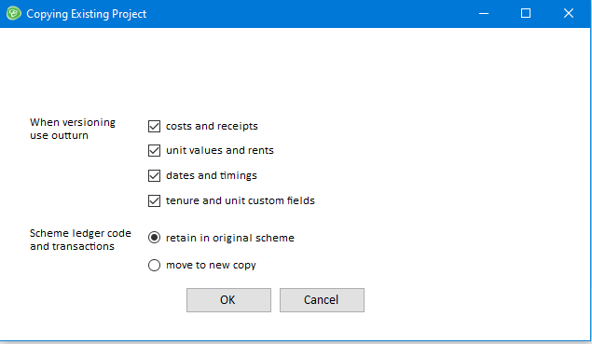
Post Approval changes
Save as version – pick & mix originals or outturns

Slide 21
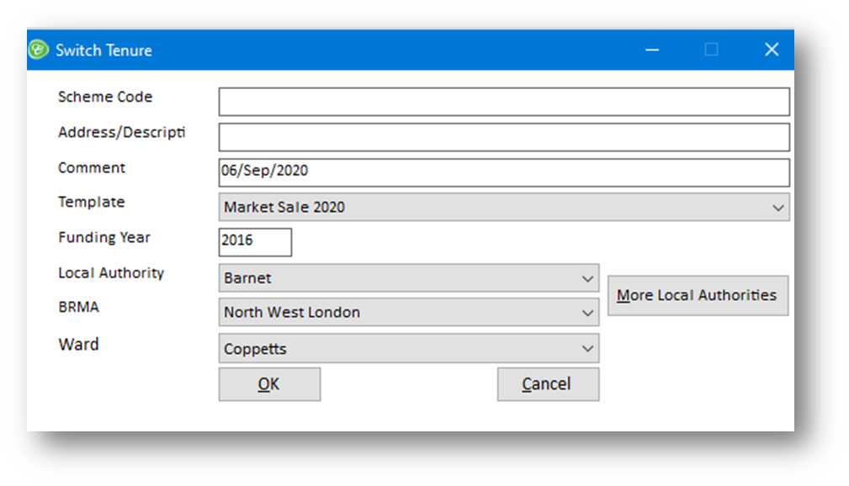
Post Approval changes
Switch Tenure
Save as first to create an unlocked appraisal and then Switch Tenure
Carbon copy of the unlocked appraisal with the ability to change tenure details AND the tenure (template)
Still able to change units, costs, timetable
Useful for doing multiple appraisals for similar sites/offers

Slide 22
Assumption Changes
Inflation
Interest Rates
Discount Rates & Periods
Revenue Costs
Create new templates for new projects
Live sensitivity through the Appraisal Calculation

Slide 23
Snapshots
Automatically taken at change in status
Read-only
Appraisal Calculation can be viewed as it was when the snapshot was taken

Slide 24
Questions?
Pamwin User Group| 10 September 2020

