Slide 1
The PanConnect M3Pamwin App
DIGITAL SOLUTIONS
FOR SOCIAL HOUSING LANDLORDS

Slide 2
About us
Formed partnerships to achieve the right solutions for the sector
We recruit to ensure we continue to deliver on time and budget
with growing demand we launched new products and new versions of our offerings
Our reputation for delivery and quality meant that our customer base as continued to grow
Established in 2011
Launched product to market in 2016
Beta sites developed with United Welsh, Trivallis & Pobl
In 2017, we grew the development team to meet demand of new customers
By 2019 we had doubled in size and
Born out of the desire to
improve business solutions and processes
Went on to grow a presence in South Wales through a proven delivery method
taking note of sector changes we continued to adapt our product
M3 Pamwin

Slide 3
What is PanConnect
PANCONNECT STAFF APP: STAFF MOBILISATION
SELF-SERVICE: CUSTOMER PORTAL & APP
COMMUNICATIONS HUB: ALTERNATIVE CONTACT SOLUTION
DOCUMENT MANAGEMENT: STAFF APP & SELF-SERVICE DOCUMENT CONTROL

Slide 4
What you will see
How our platform integrates with back office systems
How we align your business processes
Our offering in form of a customer journey: focusing on Mobilising Staff to create efficiencies and offering additional Modules to add value and generate results

Slide 5
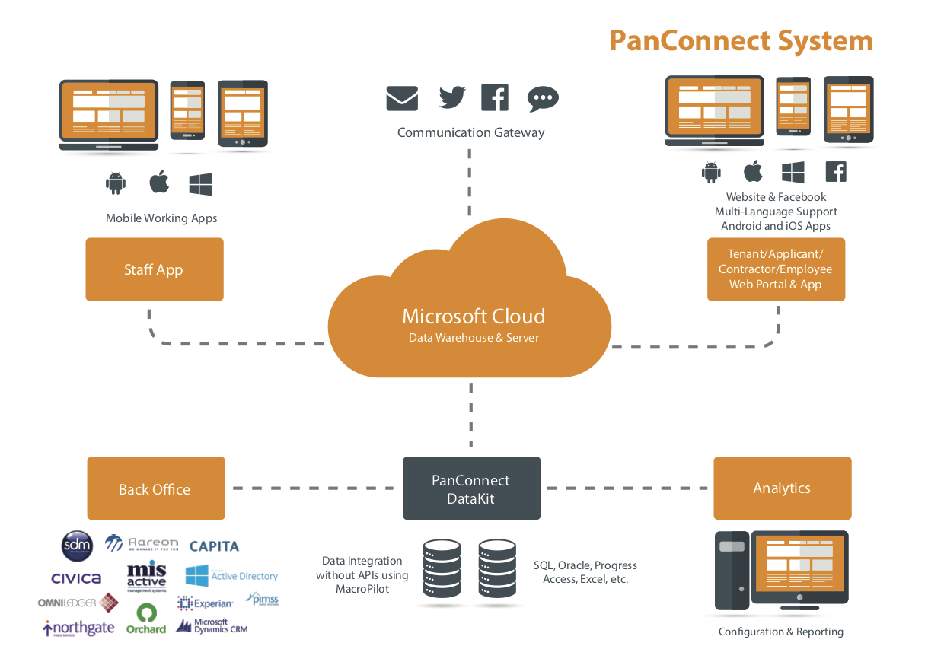
How it all works
M3Pamwin

Slide 6
The Digital Journey
New Build Properties
M3Pamwin

Slide 7
Creating Efficiencies
PanConnect Staff App allows true mobile working and operative access
No need for connectivity to any back-office system
Role based sign on
Data extraction can be from multiple systems
Digital Work Tray
Accessible on multiple platforms
Can be used across any area of the business

