Slide 1
What’s new
Session 2 | 12 July 2022

Slide 2
Outline
New look and feel
Flexible milestones
Other features

Slide 3
Look and feel
New colour scheme
New screen and menus layout
Redesigned grids

Slide 4
Flexible milestones
No hard wired milestones
Stages in Pamwin now have a start and end date
Any stage can be timed against
Gantt chart now behaves more like MS Project

Slide 5
Other features
Blank report
Save as Version
Beefed up audit trail
Grant per property
Performance tweaks

Slide 6
Questions?
What’s new | 12 July 2022

Slide 7
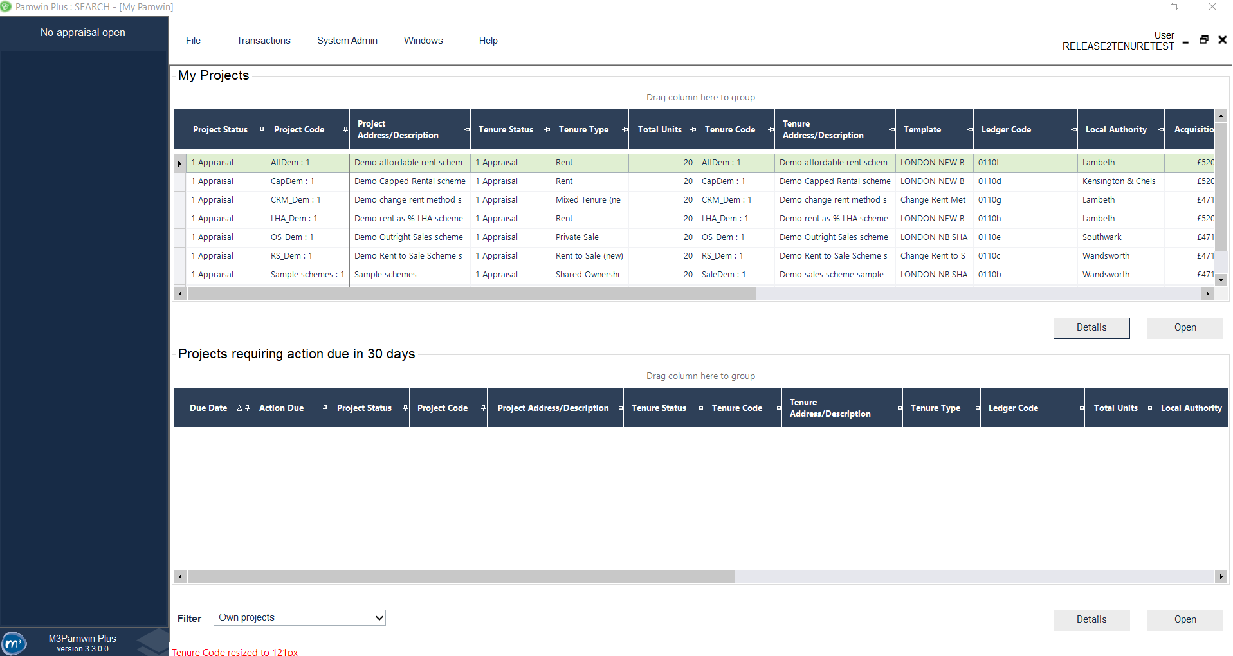
New look and feel

Slide 8
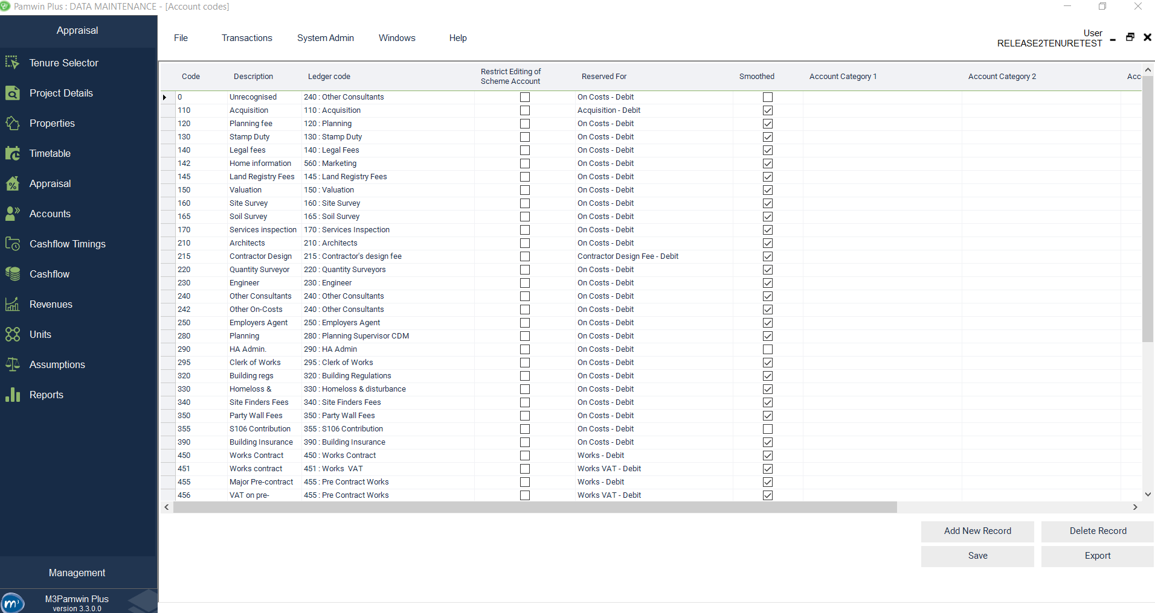

Slide 9
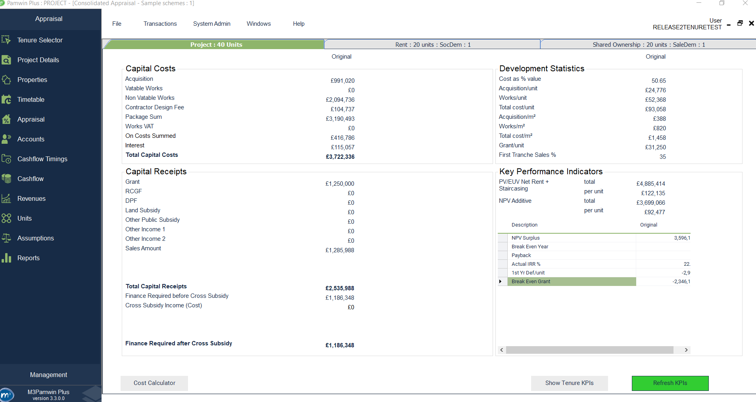

Slide 10
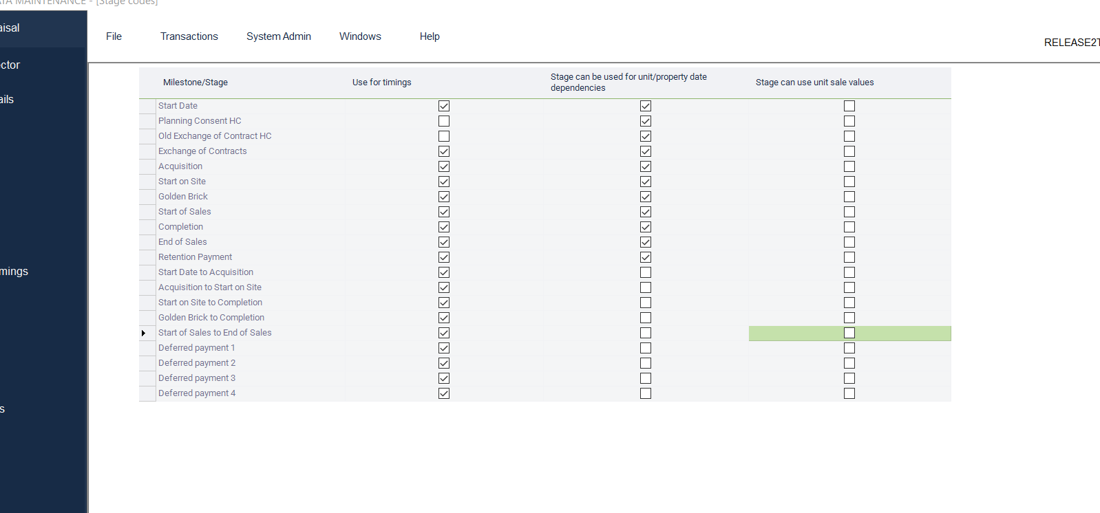

Slide 11
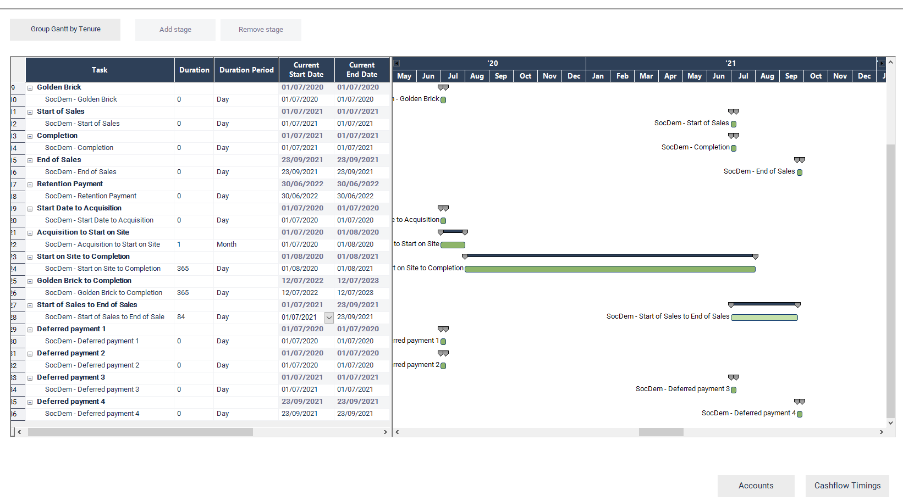

Slide 12
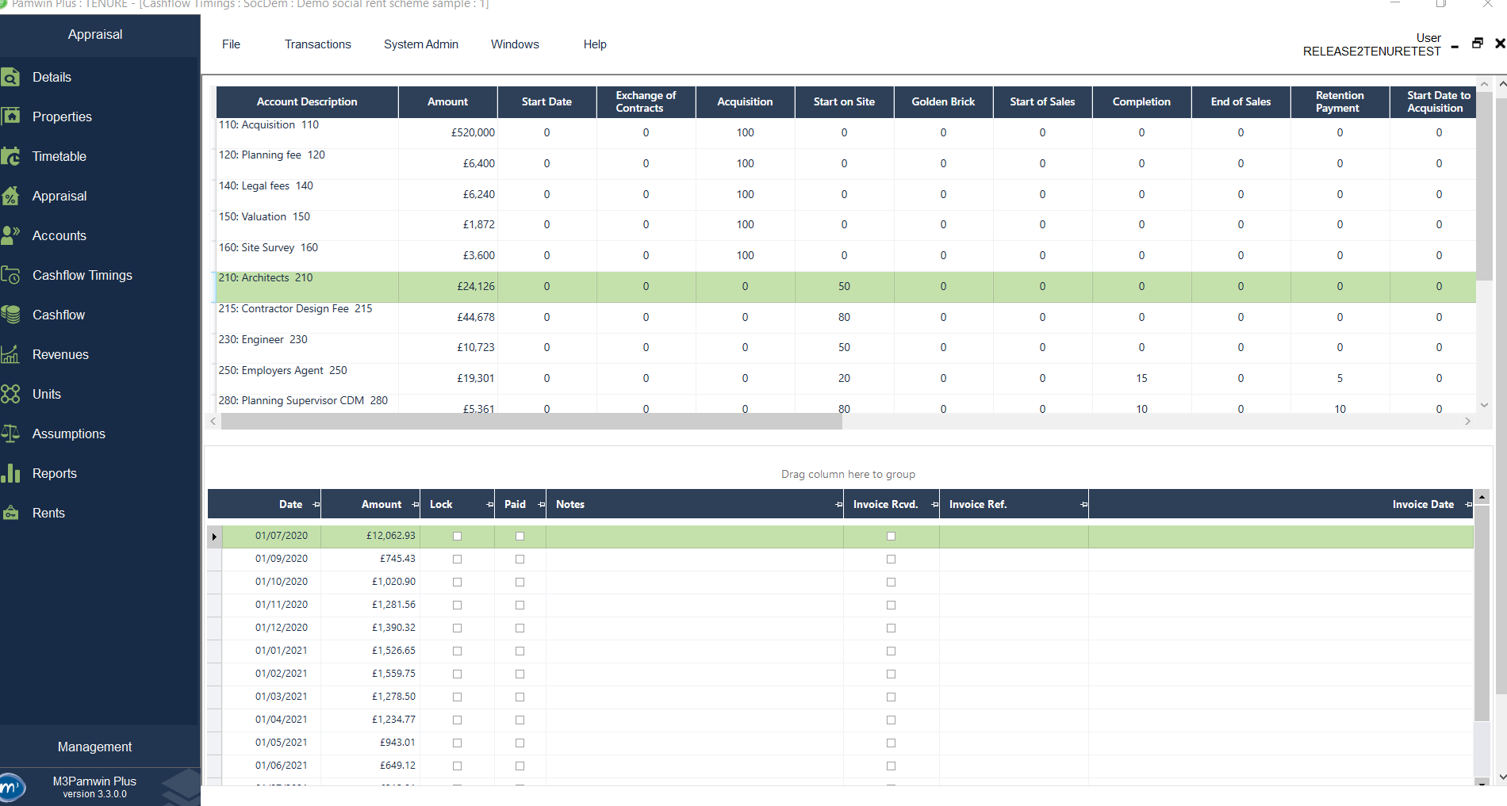

Slide 13
Thank you all for attending!
What’s new | 12 July 2022

