Slide 1
Making OSM Viable
Initial Study Outcomes

Slide 2
Off-site manufacture
1837
Manning Portable Cottage
1940s
UK: Post WW2 modular homes
2020s
Modular is once again “the in thing”
A company is an association or collection of individuals, whether natural persons, legal persons, or a mixture of both. Company members share a common purpose and unite in order to focus their various talents and organize their collectively available .
Notes:
Modular has been around for a long time…. Why are we revisiting now?
From 1837: Henry Manning designed portable cottage for his son emigrating to Australia. Thousands of portable cottages shipped since then
1940s: Cheap and easy to construct prefab homes built to help address housing crisis post-WW2
Now: No longer seen as cheap and of poor quality – embraced by government

Slide 3
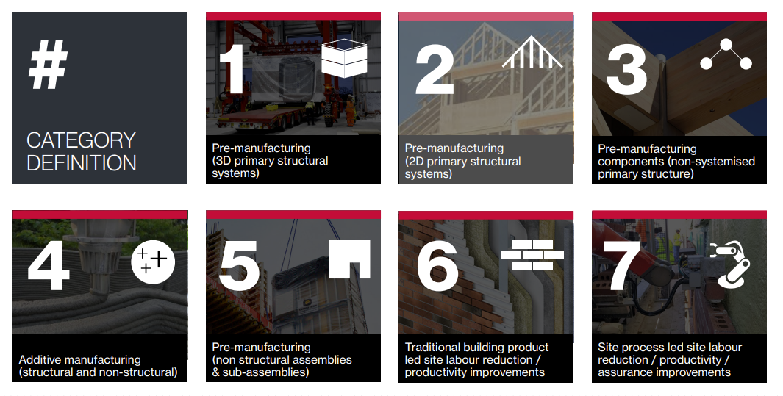
Excerpt from the report “Introducing the MMC Definition Framework” by the DLUHC MMC Working Group
Notes:
Only going to focus on categories 1 & 2!

Slide 4
OSM Timescales (20 homes)
Manufacture
4 months to build in factory
Deliver
1 month to deliver all homes
Complete
3 months to “zip up”
Allowing time for groundworks
A company is an association or collection of individuals, whether natural persons, legal persons, or a mixture of both. Company members share a common purpose and unite in order to focus their various talents and organize their collectively available .
Notes:
Should be quicker after groundworks.
One manufacturer estimated it would take 8 months to deliver 20 home scheme
Delivery can be an issue – not all sites suitable

Slide 5
Where I’m going with this…
Why are we talking about OSM?
Background to the study
Scope of the study
Initial findings
Input from clients
Notes:
Will be an opportunity for questions at the end if time permits. Otherwise, feel free to catch me and any of the orgs participating in the study in the coffee & lunch breaks.

Slide 6
Why are we talking about MMC?
Affordable Homes Programme Requirement
Net Zero by 2050
Upskilling of labour
A company is an association or collection of individuals, whether natural persons, legal persons, or a mixture of both. Company members share a common purpose and unite in order to focus their various talents and organize their collectively available .
Notes:
AHP – 25% for larger developments. PMV of 55% build off-site
Energy efficiency
Committed to net zero by 2050
MMC already more energy efficient – using AHPs, and more energy efficient components
Over the past 12 months, the average number of vacancies in construction for each over-lapping quarter is 38,000.
Highest since records began
Modular factories can train up workers from scratch. 60% in Ilke factories (?)

Slide 7
Bromford has a problem…
Sites identified to deliver OSM for 21-26
Appraisals carried out
The sites weren’t viable
Land couldn’t be bought
A company is an association or collection of individuals, whether natural persons, legal persons, or a mixture of both. Company members share a common purpose and unite in order to focus their various talents and organize their collectively available .

Slide 8
Why weren’t they viable?
Assumption that OSM is 20% more expensive than Trad build
Land offer = NPV less capital costs
20% higher build costs = lower land offer
But… The Appraisal assumptions were still based on Trad units
A company is an association or collection of individuals, whether natural persons, legal persons, or a mixture of both. Company members share a common purpose and unite in order to focus their various talents and organize their collectively available .

Slide 9
MMC study devised to test assumptions

Slide 10
Build Costs
The total build cost might be close to, or lower than, trad
Regional cost variations might reduce the gap
A standard MMC cost profile should be possible
The standard profile might be cost-neutral on development interest
MMC should lead to a reduction in consultants’ fees
MMC could reduce HA development overheads

Slide 11
Running Costs
MMC units could be cheaper to maintain than Trad units
MMC units could reduce voids and bad debts

Slide 12
Appraisal methodology
MMC can only be appraised against Trad to Project Start
Land value could be derived on this basis
S106 pricing could be related to both project start and the handover of the unit

Slide 13
Participating organisations
A2Dominion
Abri
Bromford
Clarion
Guinness
Homes England
NHF Building Better
Ilke Homes
Legal & General Modular Homes
M3
A company is an association or collection of individuals, whether natural persons, legal persons, or a mixture of both. Company members share a common purpose and unite in order to focus their various talents and organize their collectively available .
Notes:
Have missed some orgs that participated in initial meetings, like North Wales HA

Slide 14
Methodology
Panels
Build costs
Running costs
Benchmark unit type
What unit type can best be compared?
Is regional analysis possible?
Data driven questioning
Appraisal methodology
How far back to go?
Testing through data analysis
Are the questions correct?
Has this work been done by someone else?
What weighting should be given to each question?
Looking at category 1 & 2
A company is an association or collection of individuals, whether natural persons, legal persons, or a mixture of both. Company members share a common purpose and unite in order to focus their various talents and organize their collectively available .
Notes:
Build costs decided unit type
- Settled on 4p/2b, and 5p/3b

Slide 15
Initial findings
Notes:
We do not yet have definitive conclusions
Paul Flowers leading the research putting together the report

Slide 16
Build cost findings so far…
Assuming both units built to Future Home Standards – Trad vs Modular unit costs comparable
Data from 7 Modular suppliers shows modular 3% cheaper for 2 bed / 4 person, comparable for 3 bed / 5 person
Time saving achieved after first 20 weeks (after groundworks), but still needs to be quantified
Need to establish two separate cost profiles, for superstructure and substructure
Consultant costs on average £15k lower – need to disaggregate the data

Slide 17
Running cost findings so far…
More data on life-cycle costs needs to be collected
M3 plan to introduce an online live benchmarking resource
Notes:
Clients will be able to upload data as they get it

Slide 18
Appraisal methodology findings so far…
Modular units can only be compared to Trad when Revenue and Capital cash flows should be discounted back to project start
Modular developments can be appraised in Pamwin with
Notes:
Appraise from project start:
NPV at project start looks lower due to extra year of discounting
Working on the complete findings and will present them in a paper and a seminar in due course, including how to model in Pamwin.

Slide 19
Hear from clients
Notes:
Final report and resources will be shared (initially with study group, but then with wider client base). Ask clients
How are your organisation approaching MMC or modular developments?
Have you had difficulty making the appraisal work?
Obstacles to getting buy-in? Especially from the board?

