Slide 1
The SLA – how can we help you?
Paul Flowers – Managing Director, M3

Slide 2
 | 2015 | 2020 | 2025
Working environment | Most of you are in the office | All of you are at home | Some of you return to the office
Hosting Pamwin | Most of you host Pamwin on your own servers | Major pivot to M3 hosting – most of you now ask us to host | Hosting has got more complicated due to new authentication methods
Daily running – posting transactions, setting up users, running reports | Most of you just do this, ask your IT for backup, call our helpdesk | We have to do some of these things due to the speed of change | Some of you never take back the reins (and can’t in the case of new users)
Changes – assumptions, LHAs, system upgrades | Most of you just do this, inc. before and after testing | Similarly, we step in and help | Some of you do this, others ask us to do it, others expect us to do it
Reports and APIs | We set them up, you run them | As above | Some of you ask us to continue to change reports, as a helpdesk enquiry
The core model – appraisal calc/revenue forecast | We help you set it up, you tweak it | As above | Some of you own your own models, others ask us to change, others expect us to do so
Notes:
Paul

Slide 3
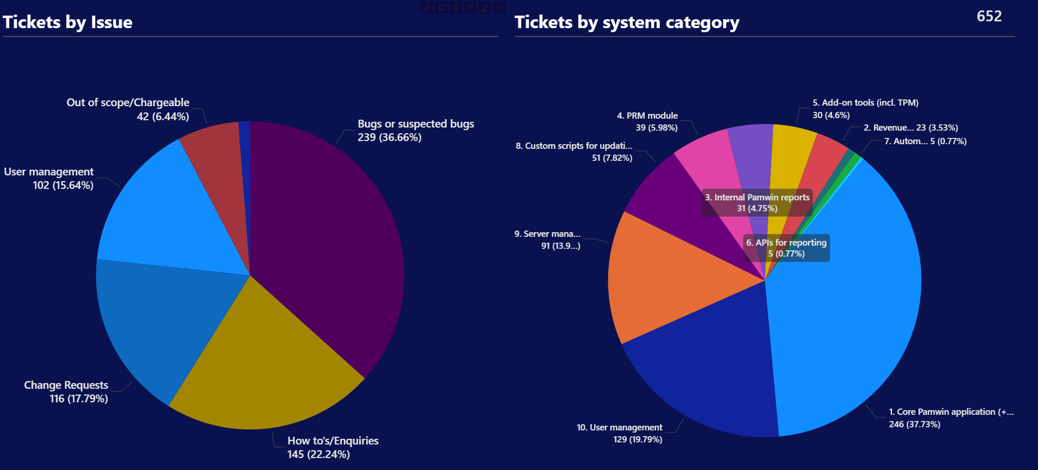

Slide 4
The need for a new contract/SLA
Contract only covers us hosting on azure, not SaaS
Saas blurs contract and SLA
We need to know what you want, and plan for a service desk alongside the help desk
  Urgent tickets lost amidst general enquiries
Notes:
Paul

Slide 5
In an ideal world: | We (client) will always do this | We would like the option for M3 to do this for us | We feel M3 should always do this
Hosting Pamwin
Daily running – posting transactions, setting up users, running reports
Changes – assumptions, LHAs, system upgrades
Reports and APIs
The core model – appraisal calc/revenue forecast
Notes:
Paul

Slide 6
In a ideal world: | We (client) will always do this | We would like the option for M3 to do this for us | We feel M3 should always do this
The Contract/ SLA | SLA will not reference these points , or make it clear they are excluded | SLA will set out optional chargeable services | SLA will say what we provide as standard
M3 categories to have response and resolution targets
Helpdesk to have separate categories
Notes:
Paul

Slide 7
How this will work
Groups of 5
First topic
Discuss – 5 mins
Stick up on board
Whole UG discussion
Next topic
Notes:
Paul

Slide 8
Daily Running – ideal world | We (client) will always do this | We would like the option for M3 to do this for us | We feel M3 should always do this
Posting transactions, inc backup beforehand
Setting up or removing users
Running reports inc overnight
Data cleansing – deleting old appraisals etc
Other
Notes:
Paul

Slide 9
Changes – ideal world | We (client) will always do this | We would like the option for M3 to do this for us | We feel M3 should always do this
Our own financial assumptions – before and after testing
LHAs and social rent – before and after testing
System upgrades – before and after testing
Data cleansing – deleting old appraisals etc
Other
Notes:
Paul

Slide 10
Reports and APIs – ideal world | We (client) will always do this | We would like the option for M3 to do this for us | We feel M3 should always do this
Changing the PRM report – new sheets or formats
Adding new sheets to a standard old report
Writing database views or queries
Amending model used by Power BI
Other
Notes:
Paul

Slide 11
The core appraisal model – ideal world | We (client) will always do this | We would like the option for M3 to do this for us | We feel M3 should always do this
Adapting the core Pamwin sheets to meet new regs, changes to modelling world
Adapting client bespoke sheets or reports
Switching to a new model – Rev 6 to 7 – before and after testing
Aligning Lite to Plus – confirming client specific outputs
Other
Notes:
Paul

Slide 12
In a ideal world: | We (client) will always do this | We would like the option for M3 to do this for us | We feel M3 should always do this
The Contract/ SLA | SLA will not reference these points , or make it clear they are excluded | SLA will set out optional chargeable services | SLA will say what we provide as standard
M3 categories to have response and resolution targets
Helpdesk to have separate categories
Notes:
Paul

Slide 13
What happens next
Analysing the results
Coming up with a plan
  Standard SLA
  Enhanced covering optional areas
  Proposed response and resolution times
Consultation – September
Ratification – December user group
Notes:
Paul

