Slide 1
Pamwin Lite
Pamwin Plus
Sundeep Heer – Head of Consultancy
Notes:
Welcome to training
Introduce yourself

Slide 2


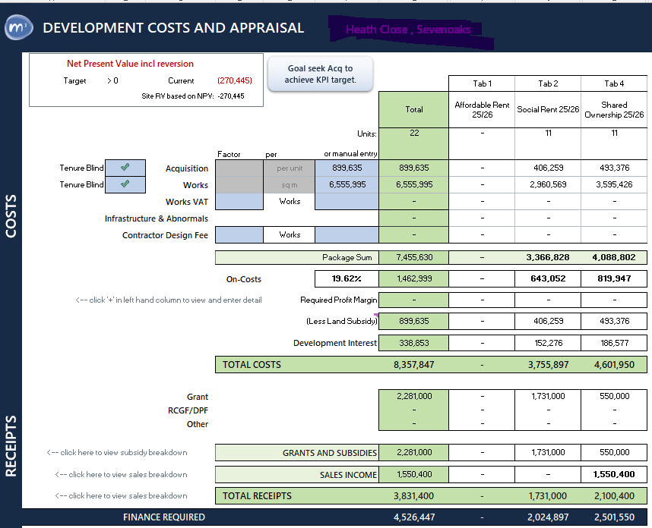


What is Pamwin Lite?
Quick Site RV
Live goal-seek on Residual Land Value
Land valuation and project viability
Built in assumption set
Annually Benchmarked assumptions and standard KPIs.
Full monthly development cashflow.
Reliable models for all tenures
Standardised models for affordable rent, private sale, shared ownership, for new build, regen and refurb projects
Updated regulatory tables
LHAs, Target Rents & inflation update applied annually.
Easy stress testing
Sensitivity and scenario modelling against short and long term economic assumptions.

Slide 3
Pamwin Lite

Slide 4

How Pamwin Lite integrates with Plus?
Matching Configuration
Ensures templates & assumptions stay aligned
Comparable Results
Both produce consistent and comparable outputs
Streamline option appraisals
Reduce the number of redundant appraisal in Plus
Notes:
Clients have successfully been using Lite and Plus together for years now, importing from Lite to Plus before the project has formal approval.

Slide 5
Demo Lite to Plus

Slide 6

Best practice when using Lite & Plus
Control version and file location
Maintain templates alignment
Define use of Lite & Plus
Establish handover points (Lite → Plus)

Slide 7
Key differences between Lite & Plus?
Lite Plus
Tasks Fixed Flexible
Interest Monthly Daily
Funding Streams Flexible Less flexible
Cashflow Forecasting Structured Structured & Manual option
Reporting Standard Standard & configurable
Scenario modelling Built in Save as/Save as Version

Slide 8

When Do Projects Need Reassessment?
Sales Challenges – units not selling
Contractor Issues – goes pop!
Initial miscalculation – wrong tenures
Scope changes – more/less units

Slide 9
Appraisal to Approval back to Appraisal
Detailed Appraisal
Approval Process
Live Appraisal
Offer/Initial Appraisal
Conditional Offer
Export to Lite

Slide 10
Demo of Plus to Lite

Slide 11

Benefits of Reverse Integration
Rapid scenario testing without rebuilding from scratch
Consistent data between the two platforms for easy comparison
Efficient management of options appraisals

Slide 12
Considerations
Import must be xlsm. Xlsb.
Decision on old templates?
Road map – Aug. 6.1 plus should be self service
Manage file location – or be able to use offline.

