Slide 1
Pamwin User Group
02 December 2020 | Online

Slide 2
Welcome!
Paul Flowers
Matt Snuggs
Sundeep Heer
Lorraine Boyle
Paolo Aquino

Slide 3
Housekeeping
Questions – chat or in person
Recording – can edit you out if needed
Feedback
Post session zoom

Slide 4
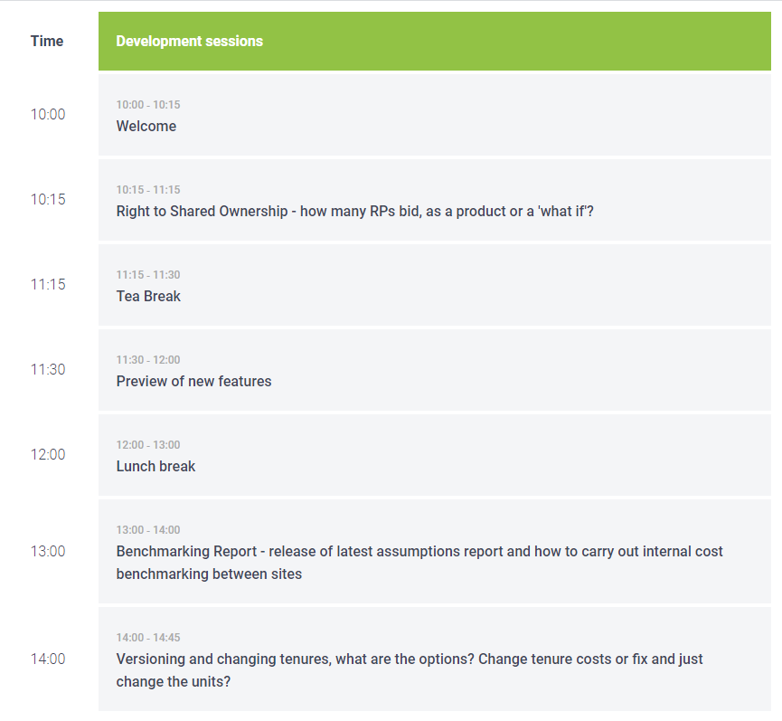
Timetable

Slide 5
Company news
New recruits
M3Central – new team
Leak monitoring
Pamwin data app - JV

Slide 6
MMC
Bromford - proposing working party
Best way to appraise
Build cost profiles
Fee reductions?
Long term running costs?
Appraisal methodology
Capturing compliance
On site and off site
M3 talking to Ilke
Working party to be formed ASAP

Slide 7
Pamwin news
3.2 out now
Gantt chart and flexible tasks underway
Phased Appraisal Calc– beta release by January
Direction of travel – Project entry, tenure secondary

Slide 8
Timetable

Slide 9
Versioning and reforecasting
Presentation venue | 03 February 2020
Presented by:
Paul Flowers
Managing Director | M3
m3h.co.uk
020 8274 4000

Slide 10
Versioning approved projects
Used for tenure switch
Option to create version using original figures, or outturn figures
Figures should match in the new version, but they don’t
The interest is often different

Slide 11
Why doesn’t the interest match?
Appraisal and Approved have different rules
The project is copied into an appraisal state,
Past locked payments represent actual transactions
Appraisal projects don’t drag forecasts forward to now
If milestones in past, the cash flow is forecast in the past
When the project is reapproved, the cash flow rules switch back
Past payments dragged forward
Interest changes again

Slide 12
Forecasting rules
On screen | Appraisal | Approved
Past – unlocked | Move with the milestone | Dragged forward to now
Past – locked | Stays locked | Stays locked
Both past and future (s curve) | Standard s curve | Past deleted, smoothed over future
During posting | Pre-approved | Approved
Past – unlocked | Move with the milestone | Dragged forward to now
Past – locked | Stays locked | Deleted, dragged forward to now
Both past and future (s curve) | Standard s curve | Past deleted, smoothed over future

Slide 13
When is reforecasting triggered
Not always obvious
Changes to the project
Dates, times, amounts, values
KPI reforecasting
Saving
Could make past payments, save, and wonder where they are gone
Transaction posting
Which deletes all past payments

Slide 14
New proposals
Two modes, automatic or manual
Rules around when they are used
Changes to behaviour & terminology

Slide 15
Manual and automatic
Two sets of behaviour
Not determined by status
An appraisal could be automatic
An approved project could be manual
No separate mechanism for transaction posting
What happens on screen also happens when posting
(Except that reforecasting triggered on all automatic )

Slide 16
Changes to behaviour
Retention payments no longer locked
Automatic - payments fixed in past moved up (not deleted)
Could mean payments due on the same day
When copying, option to copy transactions
Paid items appear on the copy
No ‘pre-approved’ distinction
Anything with a ledger code can take payments
Use ‘override’ instead of locked or fixed

Slide 17
Rules for use
Independent of status
What should an appraisal start off with?
Presumed manual
What should happen when a project approved?
Presumed automatic
Parameter or choice?
What about when copied?
Back to manual?
Parameter or choice?
Should you control it on a project basis?

Slide 18
Questions?
Update event name | 03 December 2019

