Slide 1
Pamwin Plus: the re-write
Matt Snuggs
Product Director
m3h.co.uk
020 8274 4000
linkedin.com/company/m3housing

Slide 2
Headlines
Company re-structured
Changes etc
New roles created
Succession planning
Growth
But also….
Matt seconded to the re-write project full-time

Slide 3
2023/24
Step 1. Established high level strategic aims of re-write
Step 2. Investigat(ing): Big Questions….
Step 3. Establish resources required, write business plan, structure team and….
…..do it.

Slide 4
Strategic Aims
Replace Pamwin Lite As A Spreadsheet
Modular
Licenced By Usage
Configurability Determined By Licence
Uk Housing Data Standards

Slide 5
Strategic Aims
Rules Engines To Allow For Possible Backwards Compatibility
Ability To Define Reports In Excel
Free Trial Of System
Accessibility (Regulations?)
Option Appraiser For Vision
Push Finished Projects To Vision

Slide 6
Strategic Aims – research required
SaaS
Automatic Upgrading
Per Client Versioning
Hosting Only - No On Prem Solution

Slide 7
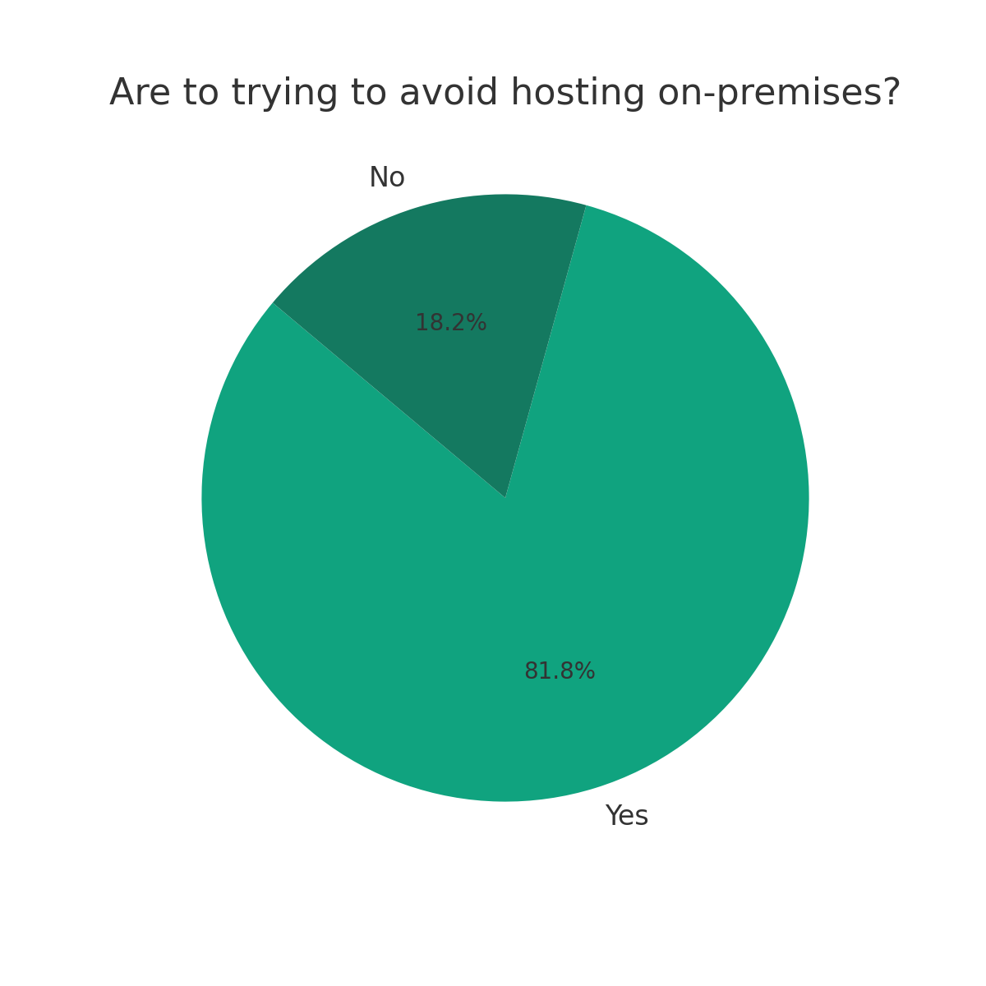
Strategic Aims - responses

Slide 8
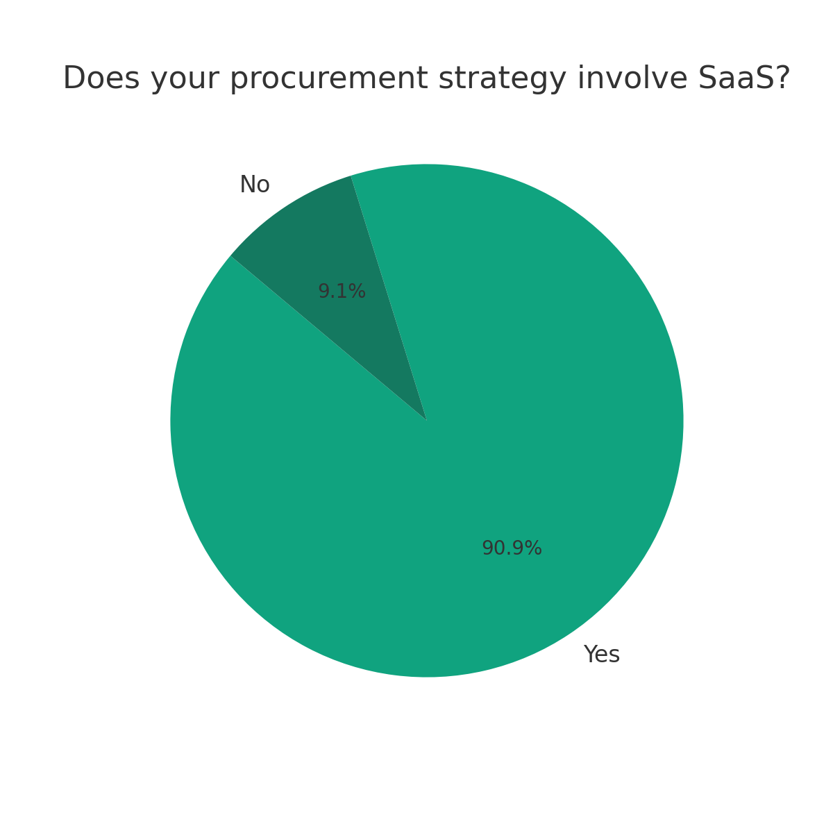
Strategic Aims - responses

Slide 9
Strategic Aims - responses

Slide 10
Other overall principles
Speed
Flexibility – simple to complex
Configuration over customisation
Avoid rigid data structures
No more tenures….?

