Slide 1
Troubleshoot and Support
Jonny Sweetman
Technical Director | M3
m3h.co.uk
020 8274 4000

Slide 2
Outline
Self service
Helpdesk
Larger scale support

Slide 3
Client zone

Slide 4
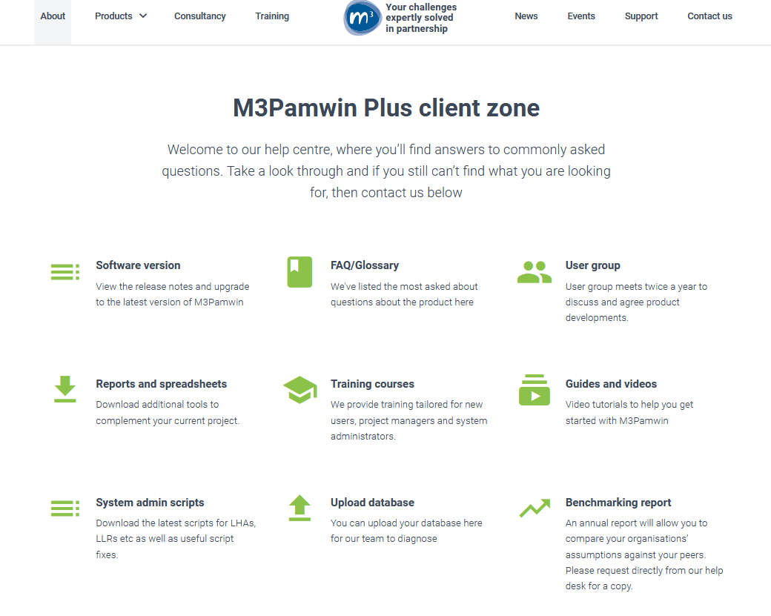

Slide 5
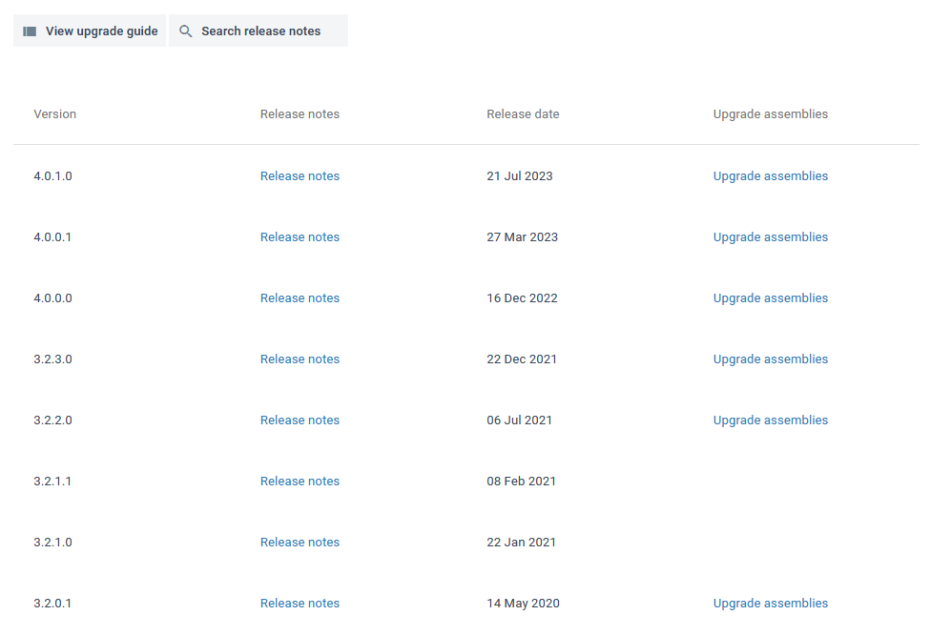

Slide 6
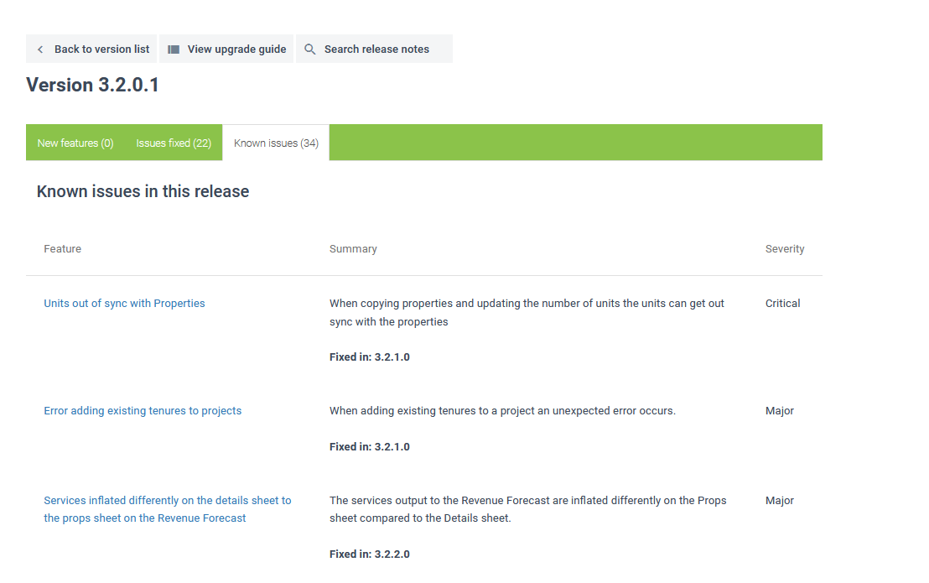

Slide 7
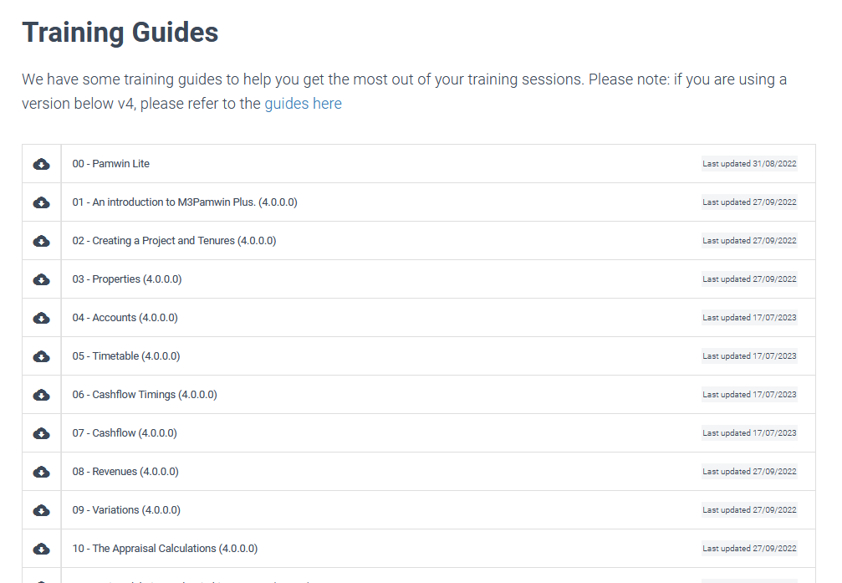

Slide 8
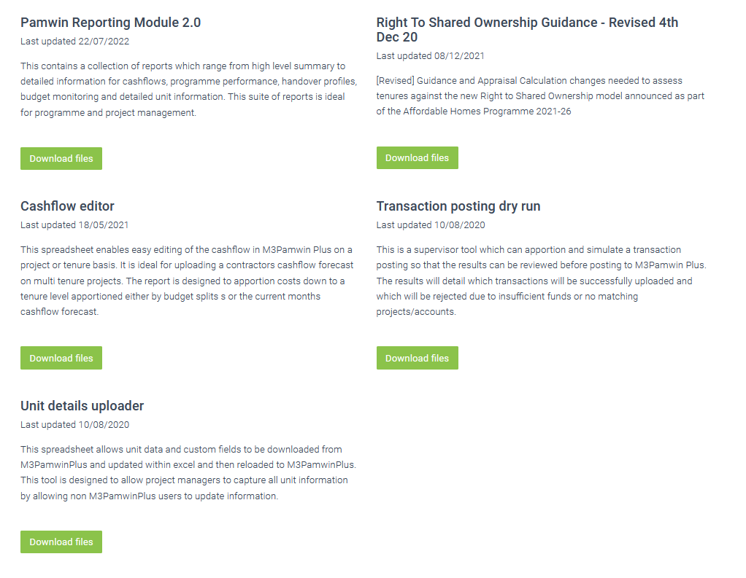

Slide 9
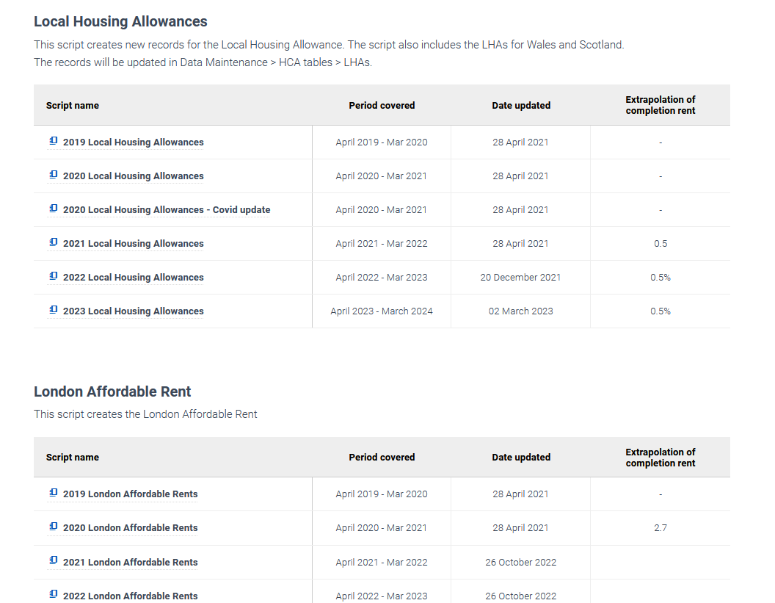

Slide 10
Helpdesk

Slide 11
The Team
Carmen Lane
Isaac Kabisa
Jonny Sweetman
The consultants
The development team
Account managers

Slide 13
How do you contact us?
helpdesk@m3h.co.uk
support.m3h.co.uk
Web chat
Account manager

Slide 14
What information do we need?
Project and tenure
What screen were you on?
What data were you editing?
Send in the revenue forecast
Send in any relevant reports

Slide 15
What happens to the tickets?
Assigned based on:
How to
Bugs
Change requests

Slide 16
Send text not screenshots

Slide 17
Ticket management
Try to keep all correspondence on the same ticket
Reply to responses rather than send new emails

Slide 18
Larger scale support

Slide 19
During implementations
Better to keep an issue log rather than flood the helpdesk
Larger scale support projects run through the account manager

Slide 20
We are here to help

