Slide 1
Pamwin User Group Welcome!
Paul Flowers – Managing Director, M3

Slide 2
Welcome!
Who’s here from M3
Housekeeping
Company News
Timetable for the day
Notes:
Paul

Slide 3
M3
Dawn Rush
Matt Snuggs
Sundeep Heer
Jonny Sweetman
Cheryl Campbell
Idris Olawale
Lorraine Boyle
Debbie Northey
Ben Virgo
Nasreen Asaria
Jon Case
Imogen Bowen
Notes:
Paul

Slide 4
Housekeeping
1.5 fire escapes
Lunch
Feedback
Notes:
Paul

Slide 5
M3 News
Office converted to training centre
Vision Asset Management
Optional lunchtime session
Frameworx
Restructure & expansion
Analyst
Co-ordinator/PM
Consultant (Vision)
ISO qualifications renewed
Notes:
Paul

Slide 6
Looking ahead to 2024
Support systems review - Jan
Further expansion
Consultant (Pamwin) - March
Consultant (Central) - June
User Group – Leeds – 30th April – 1st May
HATC to offer diplomas - September
Optional exams
Notes:
Paul

Slide 7
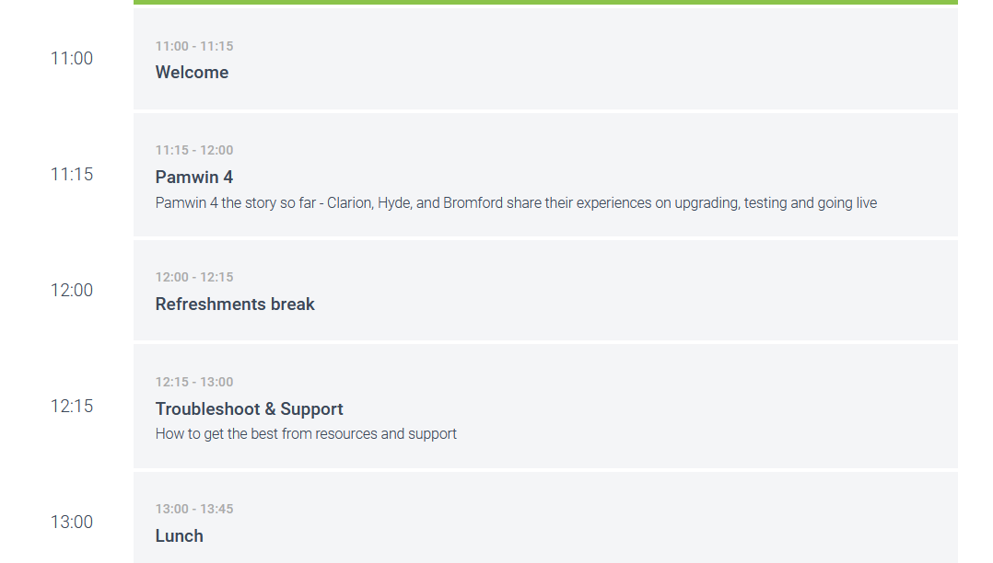
Notes:
Mike Craggs

Slide 8
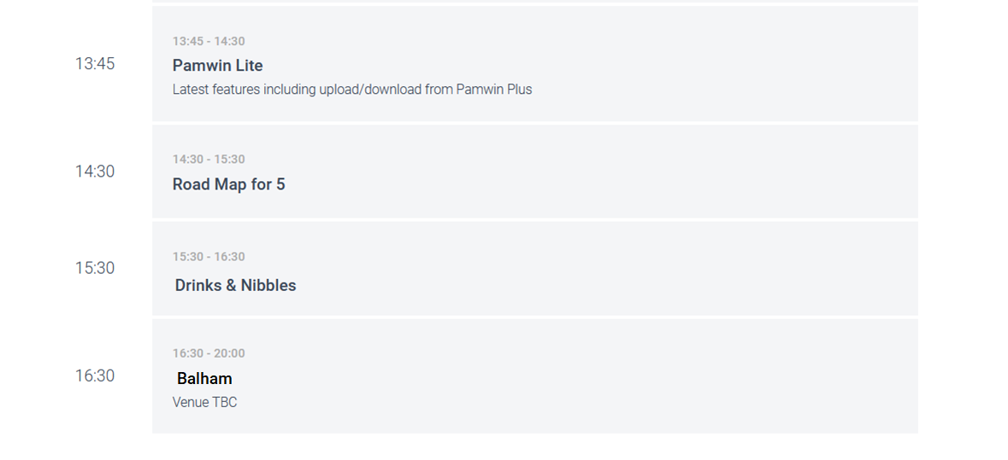
Notes:
Mike Craggs

